Slide 1
PNWHBC – 2017
Barley varieties and your
home brew
What is barley?
What is the barley and beer connection?
Grow your own barley?
Make your own malt (next session)
Random tidbits bits of science and technology
along the way

Slide 2
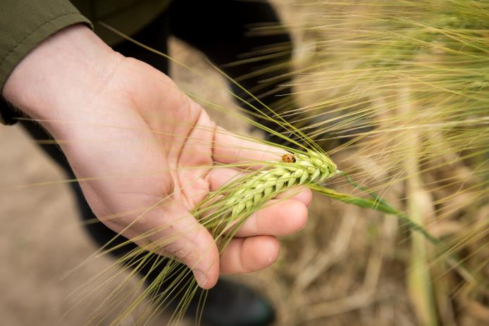
What is barley?

Slide 3
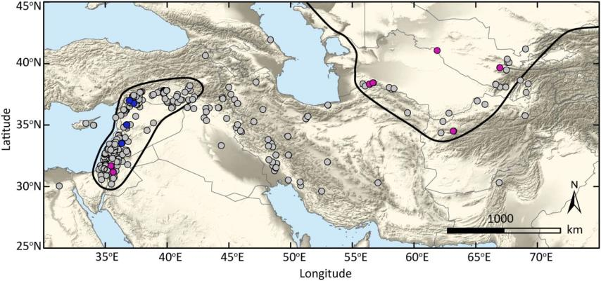
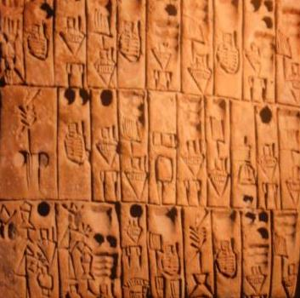
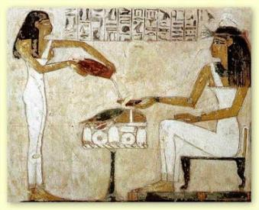
What is barley?
Hordeum vulgare
domesticated from
Hordeum spontaneum

Slide 4
What is this beer?

Slide 5
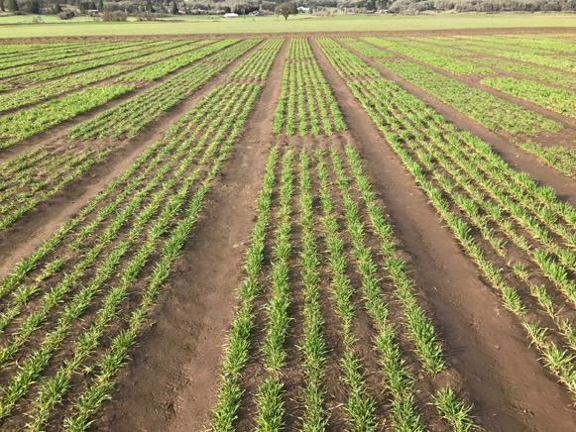
What is barley?
2-row vs. 6-row – see plants and samples
Naked vs. covered – see plants and samples
Spring vs. winter
Winter is planted. Spring is not (too wet)

Slide 6
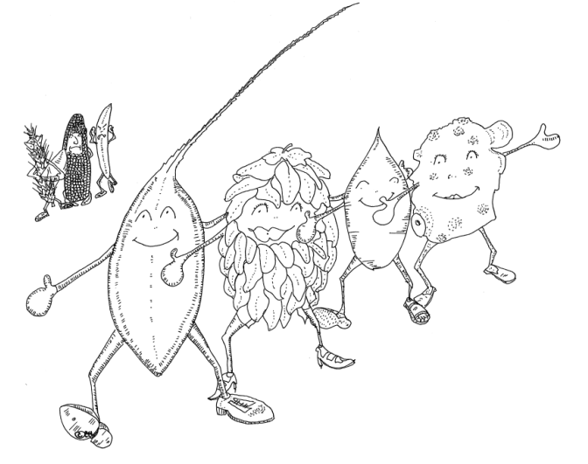
Europe
Barley and beer?
2-row covered spring
“The decree known as the Reinheitsgebot, issued in Ingolstadt in 1516, had three aims: to protect drinkers from high prices; to ban the use of wheat in beer so more bread could be made; and to stop unscrupulous brewers from adding dubious toxic and even hallucinogenic ingredients as preservatives or flavourings.”

Slide 7
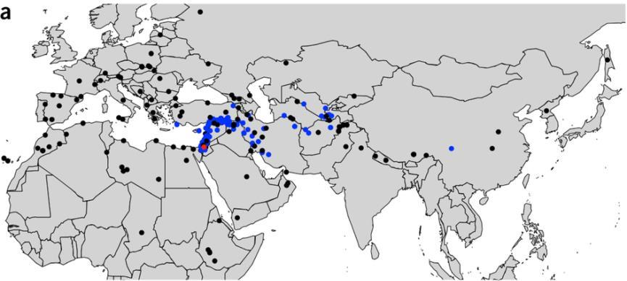
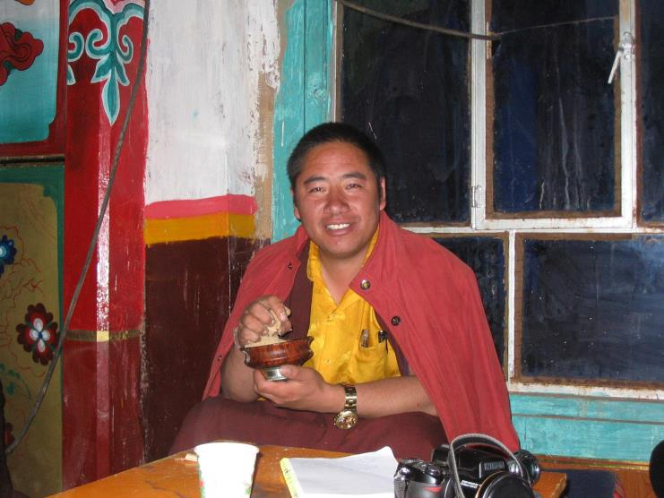
Asia
Barley and Food
2-row and 6-row naked spring

Slide 8
Barley and Beer and Food ?
+ Lautering
Insoluble fiber
The hull

Slide 9
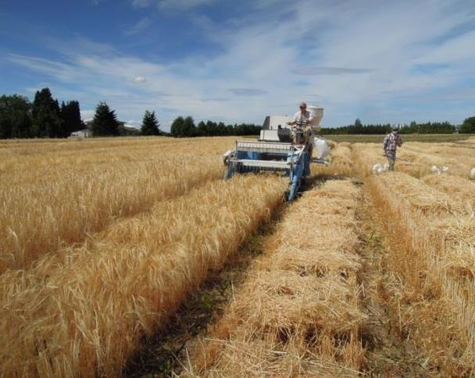
Barley and Beer and Food: OSU at your service
Facultative 2-row covered malting
Facultative 2 (6) row multi-use naked
Plots, malts, and beers
Genes, traits, and germplasm

Slide 10
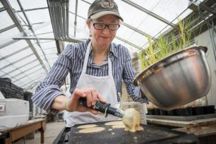
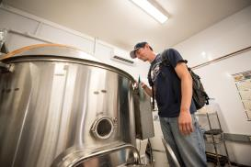
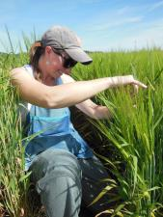
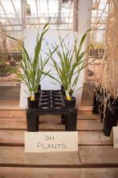
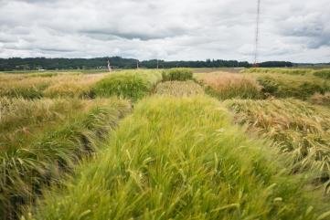
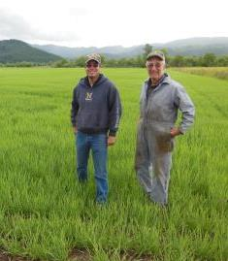
The OSU Barley Project
Crossing
0.0
5H
52_0206
3.2
A10133
3.7
A11281
A11283
12.5
A3012
13.0
A61467
13.2
A17246
15.8
5149877
19.1
5232930
Doubled haploids
21.7
52_1426
27.1
A9236
A9242
45.5
A35937
49.9
A6527
53.6
A32314
54.8
A34399
55.7
A45497
56.3
A58614
A17329
A15122
A38678
56.9
A33142
A11195
A39423
A10578
A33144
57.2
A35635
57.5
A23020
A19878
A57310
57.8
A23663
58.1
A52323
A45139
A54566
59.2
A21751
61.6
53_0654
62.2
51_1128
64.6
A62366
A16750
A62372
A14013
65.2
A27948
65.8
A58627
C13P_LOD:2.7_a:-1.3
66.0
A28098
M15H_LOD:5.8_a:-1.7
66.2
A23036
C14H_LOD:5.5_a:-4.8
C14TW_LOD:6.8_a:-0.9
66.4
A53775
66.5
A13235
67.1
A52324
C13H_LOD:10.3_a:-5.2
70.6
A28510
A40667
A25784
A38634
72.3
51_1221
51_0671
C14P_LOD:9.4_a:-6.1
72.9
52_0441
C14LR_LOD:3.5_a:5.6
74.6
A39562
C13BC_LOD:6.4_a:-3.3
74.8
A59246
C13BP_LOD:3.1_a:0.4
75.5
A2132
76.0
A21727
C14H_LOD:6.7_a:-5.4
76.4
A31634
A39567
A8401
C14L_LOD:4.8_a:-5.2
C14HD_LOD:7.4_a:-1.7
C13HD_LOD:8.6_a:-2.8
C13H_LOD:12.3_a:-5.6
C15HD_LOD:6.3_a:-2.1
77.6
A33667
M15HD_LOD:8.3_a:-1.5
C13TKW_LOD:14.3_a:-2.9
M15M_LOD:5.3_a:6.8
C14TW_LOD:7.6_a:-1
78.8
A33802
A24436
M15H_LOD:8.2_a:-2
C13P_LOD:5.1_a:-1.8
C14Y_LOD:6.9_a:-318.1
80.0
52_0713
80.6
52_0392
82.9
A4388
A44540
92.5
A60826
93.1
A16532
A40446
A16546
93.7
A16543
C14L_LOD:3.7_a:-4.6
97.3
A28760
C15BSR_LOD:5.5_a:7.1
101.6
A56808
A56807
A15768
C14BSR_LOD:6.6_a:5.5
A10413
102.2
A39511
A62319
C13BC_LOD:3.1_a:-2.3
102.8
A39701
C15HD_LOD:3.3_a:-1.6
105.7
51_1355
53_1427
111.9
51_0518
52_0526
120.1
A40885
A40886
133.2
52_0018
53_0098
135.7
52_0549
52_1168
52_0795
138.1
A29949
139.3
A35656
139.9
52_1061
A50994
A50443
A42576
A57844
Genetics and Breeding
140.5
A50995
141.1
A42579
161.6
A56719
162.8
A3016
163.1
A56725
163.4
A15237
163.8
A56720
164.2
A15242
165.1
A26145
A6950
168.9
5366981
180.3
53_0524
185.4
A17309
187.2
A47689
A52248
189.0
A61559
191.4
A19829
A19833
A19834
194.4
51_0805
200.4
51_0783
201.1
51_0095
53_0929
53_0930
202.6
A10668
204.1
A10672
A10673
208.3
A25187
210.1
53_0635
214.4
51_0819
216.2
A10187
216.9
A11995
227.0
A45575
Knowledge, Variety/Germplasm release
www.balreyworld.org
229.0
A3583
229.6
A39117
C13ST_LOD:3.7_a:-1.9
236.1
A12032
237.4
A44849
A61082
237.8
A6348
C13BC_LOD:3.2_a:-2.3
238.6
A32892
C14SPS_LOD:2.9_a:-0.8
244.4
A45211
247.8
A23407
52_1018
A43929
A43332
249.0
A44323
A44334
250.2
A55919
A51223
C13BG_LOD:5.9_a:75.1
251.9
52_0829
254.0
51_0869
262.6
A63287
A60753
A60754
263.2
A10542
C13ST_LOD:31.2_a:-4.6
264.9
52_1141
C13WC_LOD:16.5_a:-0.3
A31352
C13ST_LOD:35.2_a:-4.7
268.5
C13AA_LOD:35.3_a:-18.7
276.8
A32988
A32982
A31257
C13ME_LOD:11.4_a:-0.9
C13WP_LOD:30.1_a:-0.6
C13FAN_LOD:36.9_a:-39.6
279.8
A14908
280.4
A12049
A12052
C13BG_LOD:5_a:66.7
283.1
A61914
287.1
A44414
A22962
A59718
288.8
A19168
A55993
289.4
A54195
290.0
A37358
291.2
53_0382
293.6
51809_R
294.1
5784_F
569307
294.7
51_0857
51_0322
295.9
53_0958
297.1
5140269
53_1481
51_0401
298.3
5128167
52448_R
298.9
51881_F
547507
52048_F
300.6
53_1292
5139089
301.2
548097
302.5
546054
303.7
52_1155
305.6
53_0769

Slide 11
What is barley?
Spring vs. winter vs. facultative:

Slide 12
What is barley?
Spring vs. winter vs. facultative:
Spring:
Plant in spring and grows normally. Harvest late summer.
Plant in fall and dies of low temperature injury.
Winter:
Plant in spring and won’t flowers – stays vegetative. No harvest.
Plant in fall, vernalizes, and grows normally starting in the spring. Harvest mid-summer.

Slide 13
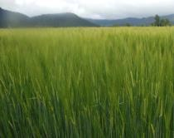
Facultative growth habit
Flexibility!
Fall planting
Cold tolerance
on demand
Spring planting
Cold tolerance
not needed

Slide 14
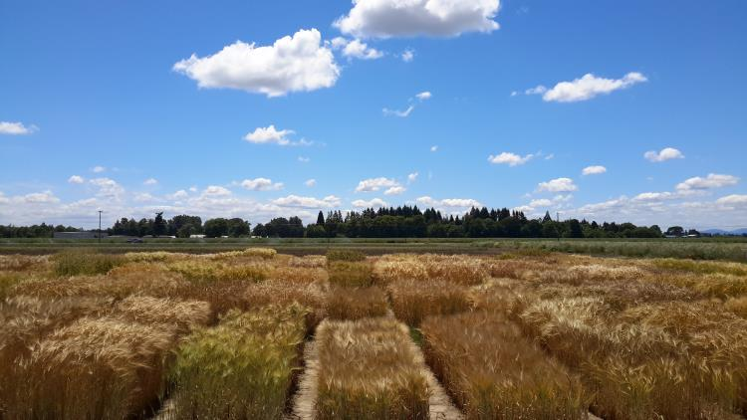
Facultative 2-row malting barley
American Malting Barley Association
OSU Pilot candidates: all facultative
DH130718: TC6W261/3/LPZ276/Charles//Full Pint
DH120412: TC6W265//Herz 29494/2991
DH130004: TC6W265//Herz 29494/2991
DH120228: Wintmalt/Charles//Full Pint
DH130939: Full Pint/Violetta

Slide 15
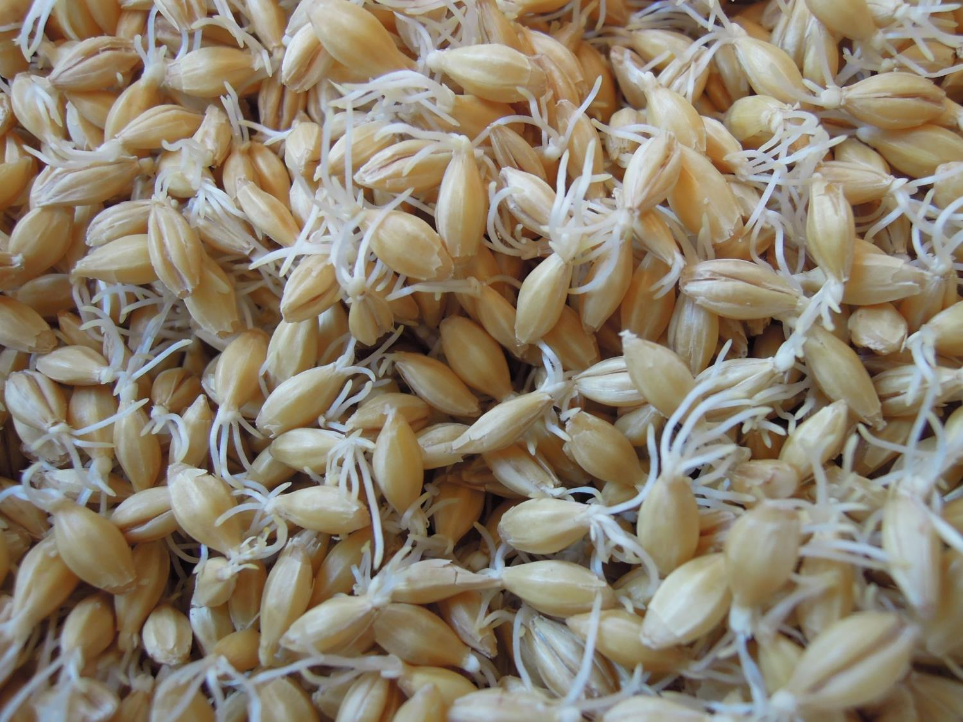

Slide 16
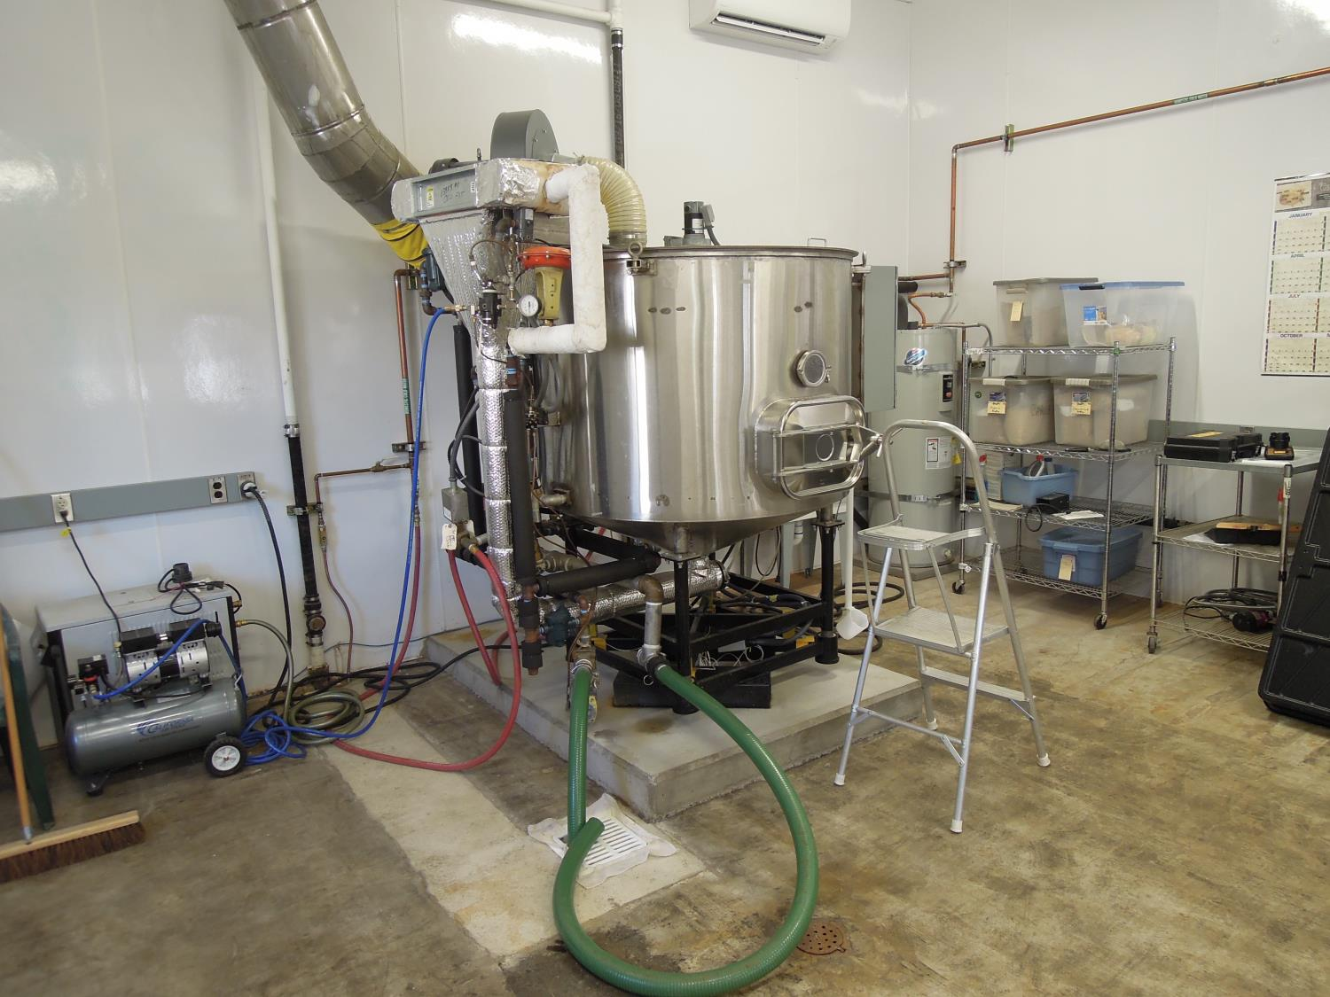
http://barleyworld.org/malt-house

Slide 17
Barley contributes to beer flavor
http://barleyworld.org/flavor
The Flavor 7-Pack
Bells, Deschutes, Firestone-Walker New Glarus,
Summit, Russian River, Sierra Nevada
Mecca Grade Estate Malting, Rahr Malting

Slide 18
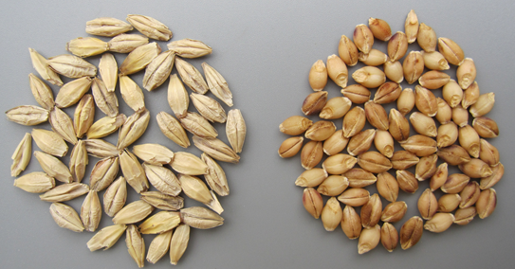
Is it time for barley to go naked after 10,000 years?
Multi-use naked barley for malt/food/feed: The NIFA-OREI grant

Slide 19
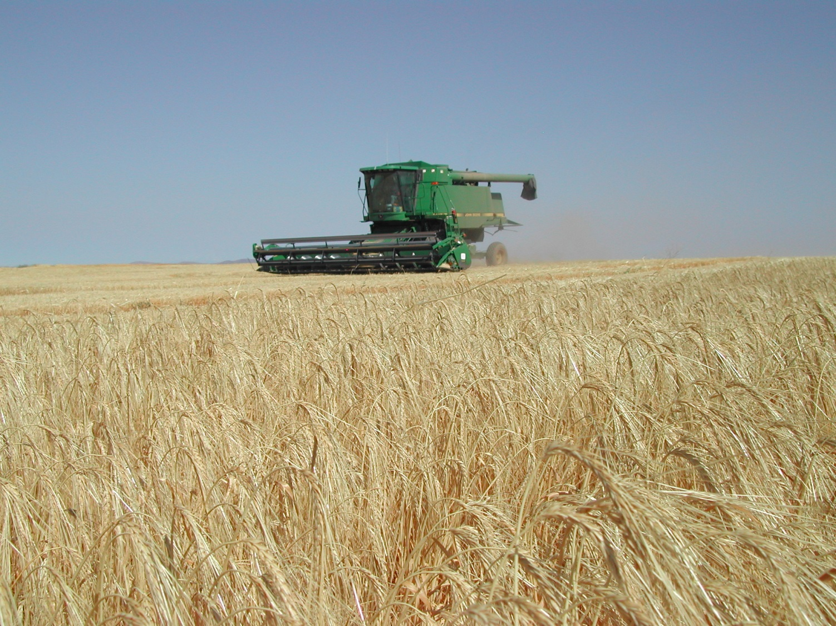

Slide 20
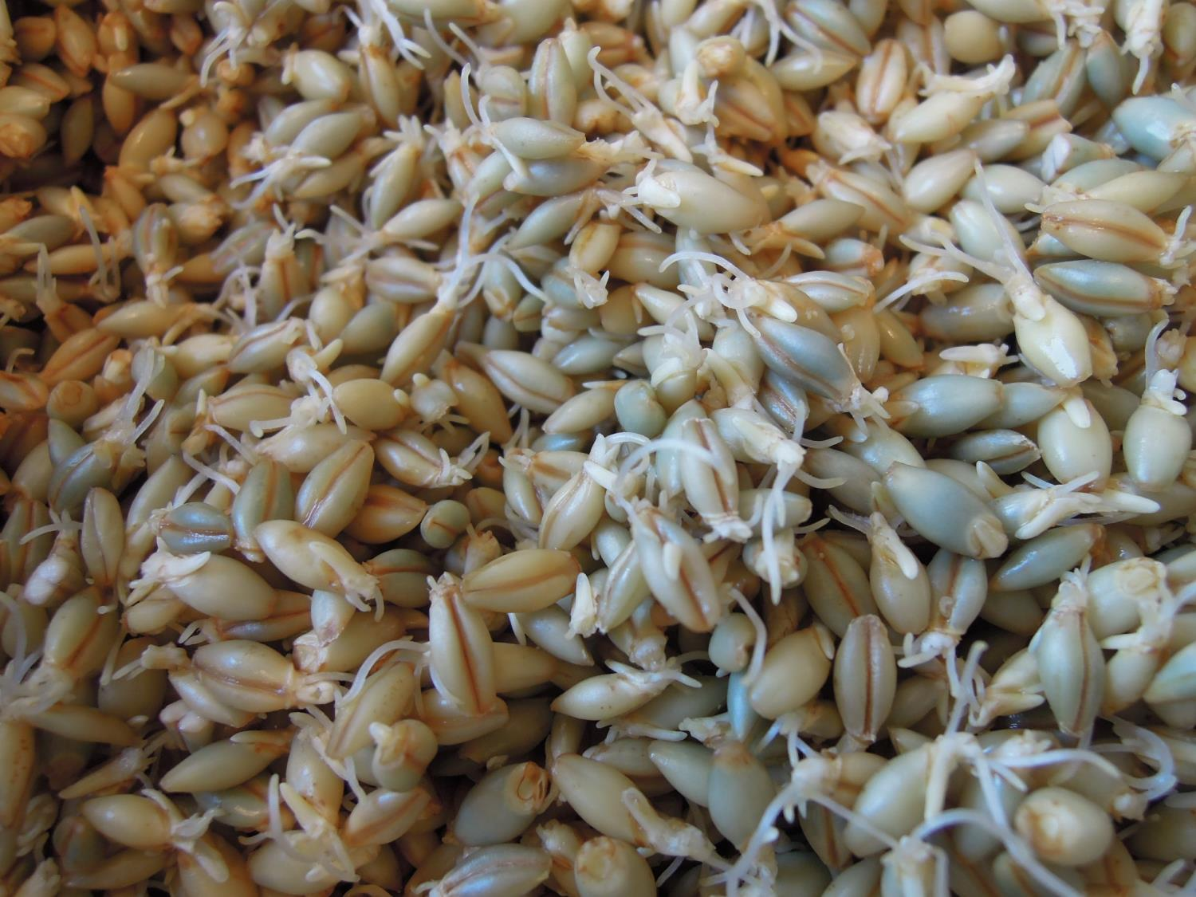

Slide 21
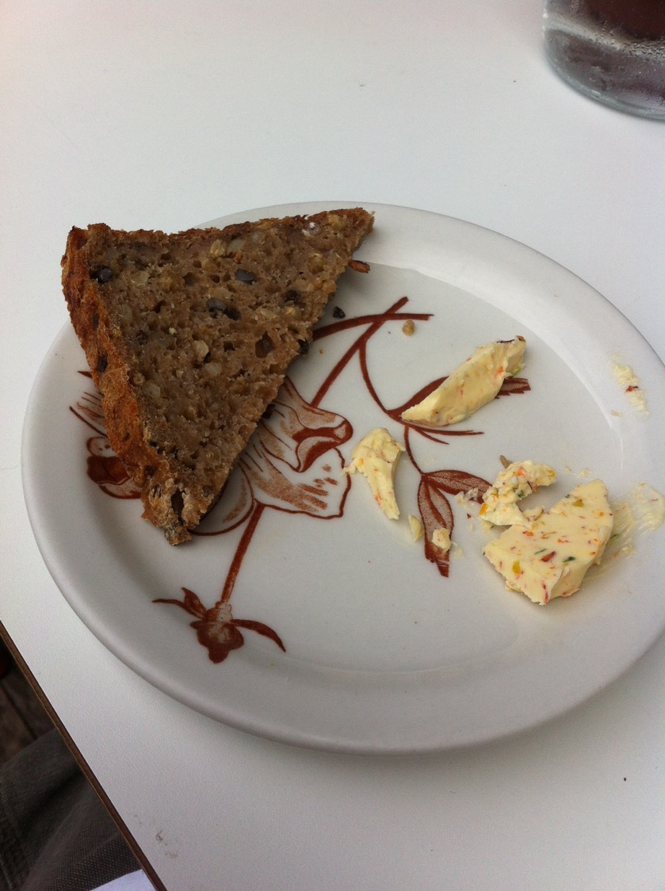

Slide 22
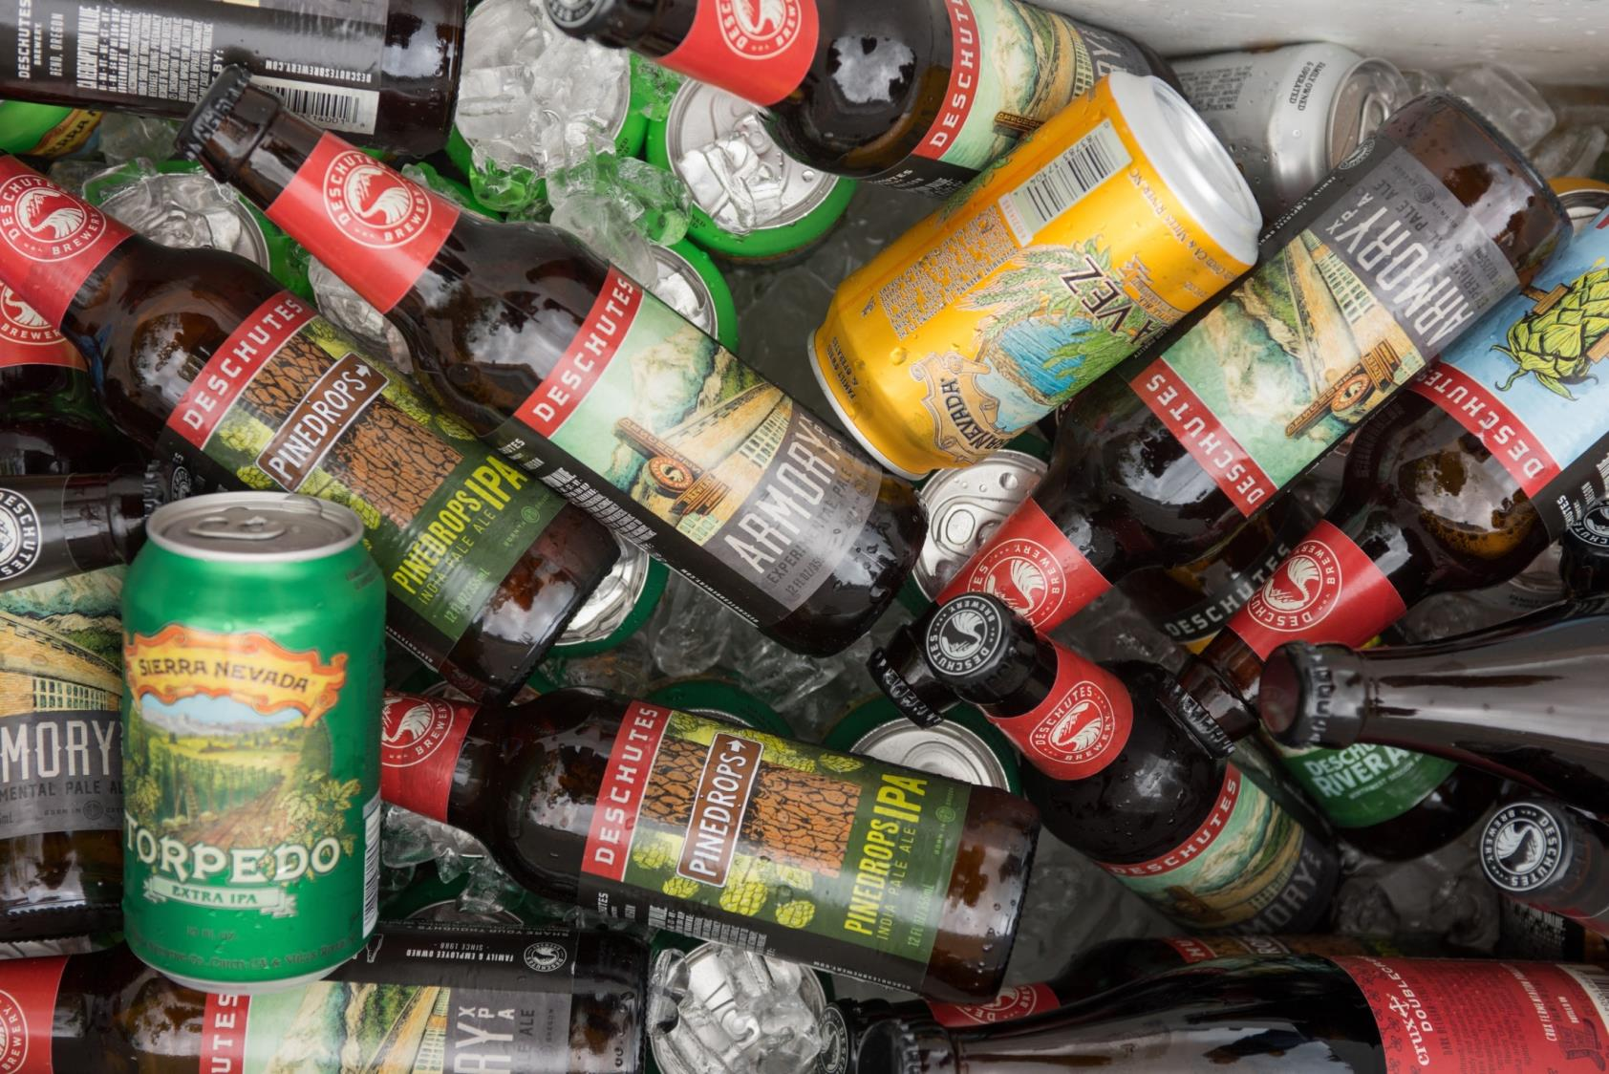

Slide 23
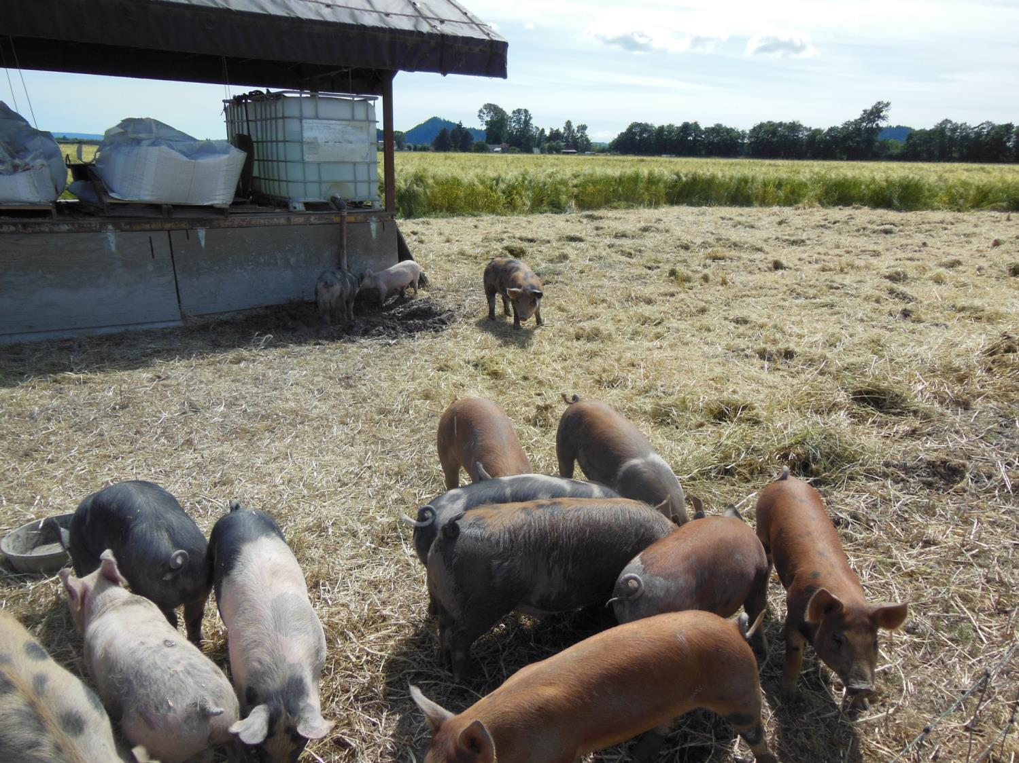

Slide 24
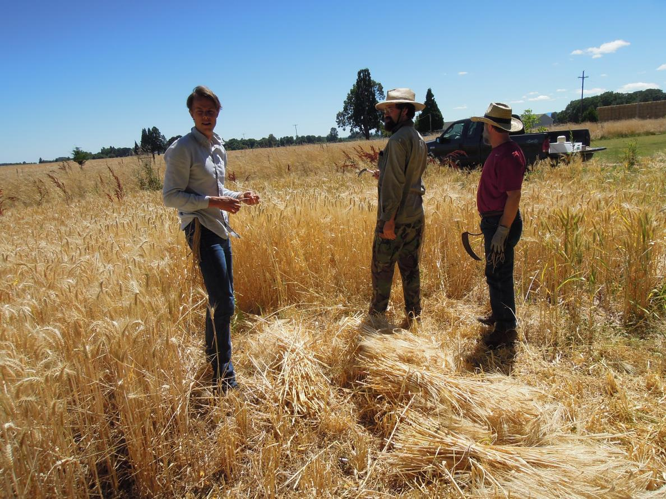
Grow your own barley?

Slide 25
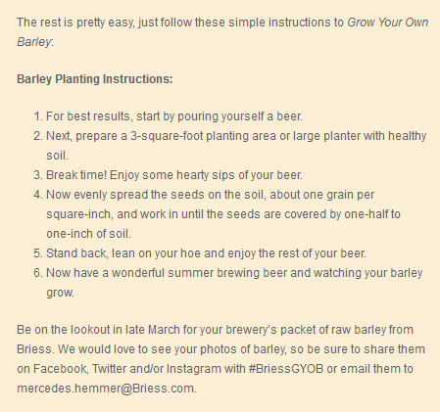
Grow your own barley?

Slide 26
Grow your own barley?
Plant 1 handful (~ 4 ounces) for 100 square feet. Rows or random
Harvest 1 – 10 lbs
Year 1: Treat the barley like you would a tomato in terms of sun, fertility, water
Year 2: Start pushing the limits on this most resilient crop

Slide 27
Grow your own barley?
Harvest
sickle
Threshing
Hmmmmm – organize a threshing bee with your local farmer or grains research program/company
Cleaning
A mesh sieve, a fan or organize a cleanathon with your local farmer or grains research program/company

Slide 28
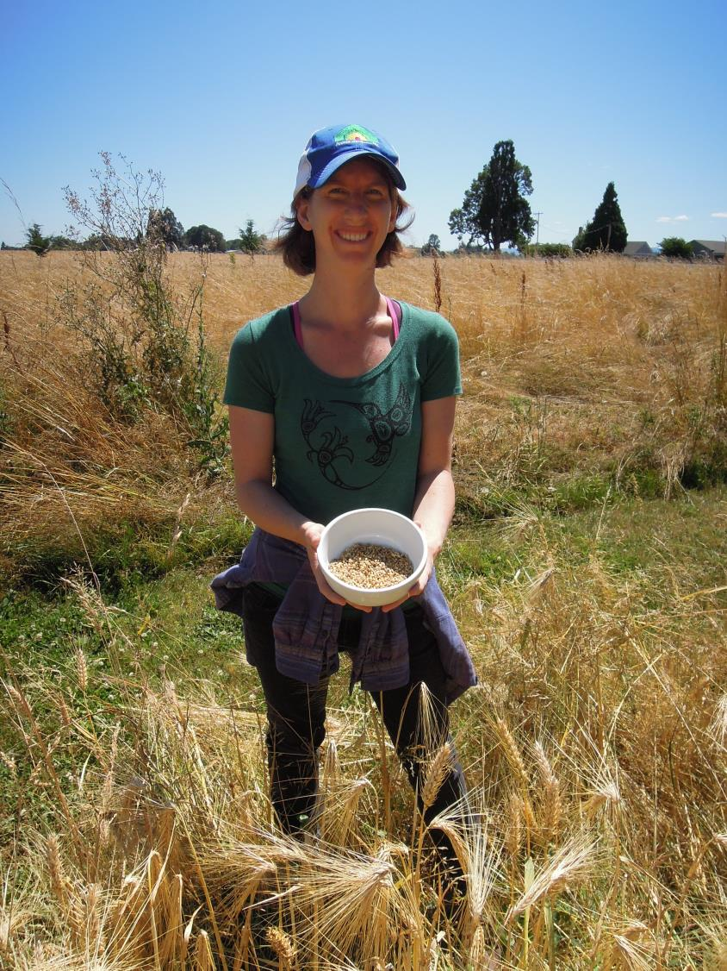
What barley to grow?

Slide 29
What barley to grow?
Malting and malting quality parameters
Barley World malts
Hartwick College CFCFAB malt analyses
Buck naked winter 6-row - taste the malt
Full Pint covered spring 2-row - taste the beer
Copeland covered spring 2-row - the ace of base

Slide 30
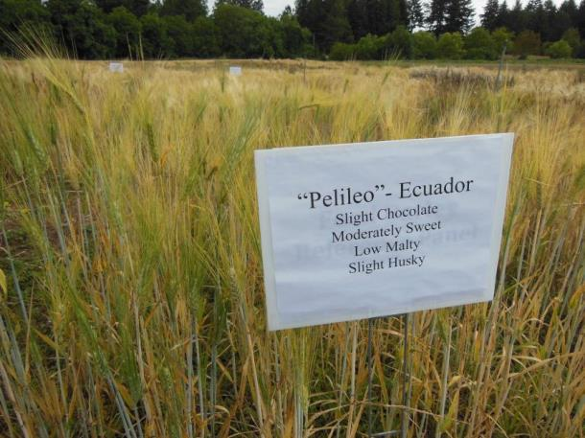
What barley to grow?
Why not take a walk on the wilder side?
Your local brew shop stocks a wonderful palette of malts
Your malting process can do amazing things with “non-malting” varieties
Newer varieties may be subject to intellectual property controls

Slide 31
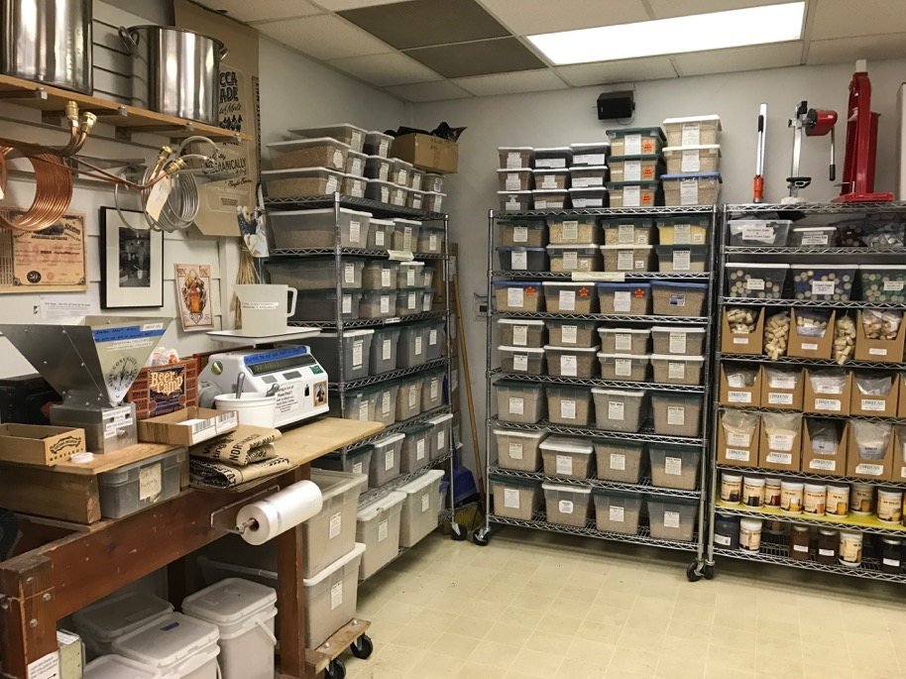
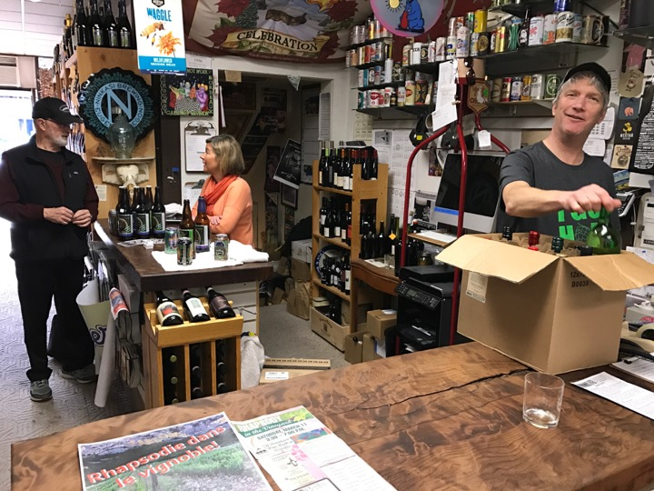
What barley to grow?
Why not take a walk on the wilder side?
Your local brew shop stocks a wonderful palette of malts

Slide 32
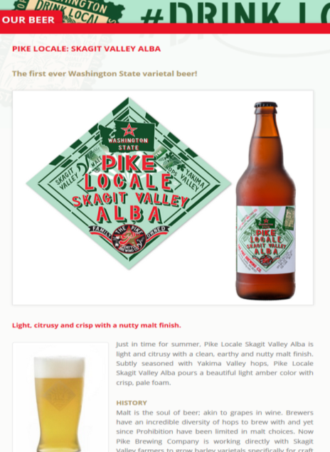
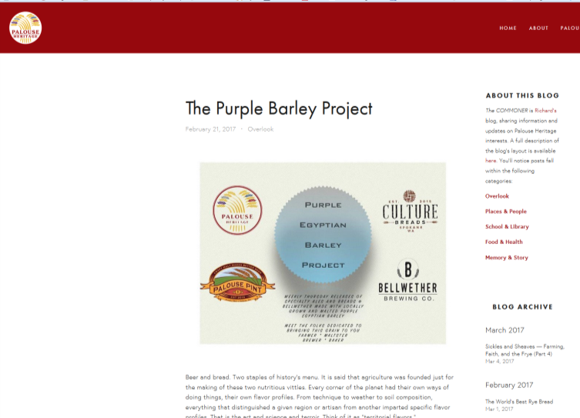
What barley to grow?
Why not take a walk on the wilder side?
Alternative malting processes can do amazing things with “non-malting” varieties

Slide 33
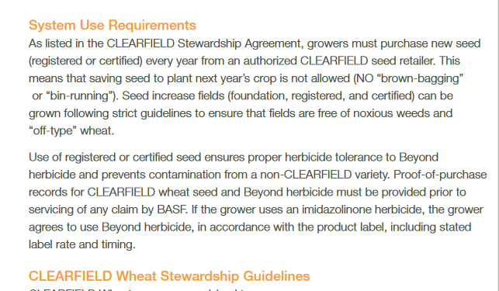
What barley to grow?
Why not take a walk on the wilder side?
Newer varieties may be subject to intellectual property controls
Plant Variety Protection ….and Beyond
The PVP is a federal law designed to promote the developments of new varieties by allowing the variety owner to determine who may sell seed of that particular variety. The law prohibits the sale of any PVP seed, including farmer saved, without the permission of the variety owner. Title V of the Federal Seed Act specifies that PVP protected varieties can be sold by variety name only as a class of certified seed. The PVP law also states that the seller must also give notice that the lot is a PVP variety. Enforcement of the PVP law is left up to the owner of the PVP variety through civil court action.

Slide 34
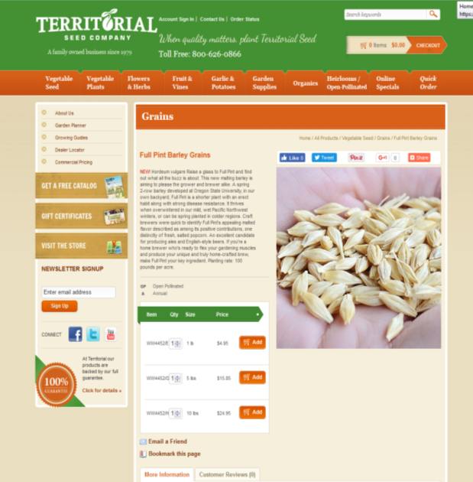
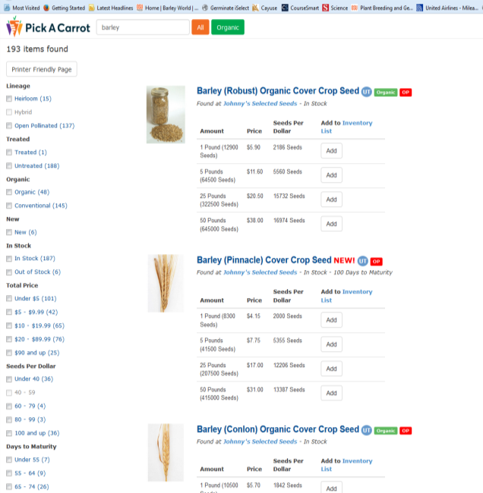
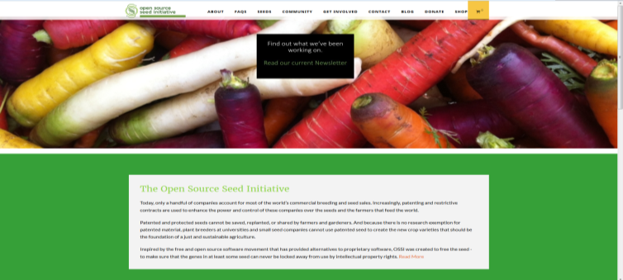
What barley to grow?
Why not take a walk on the wilder side?

Slide 35
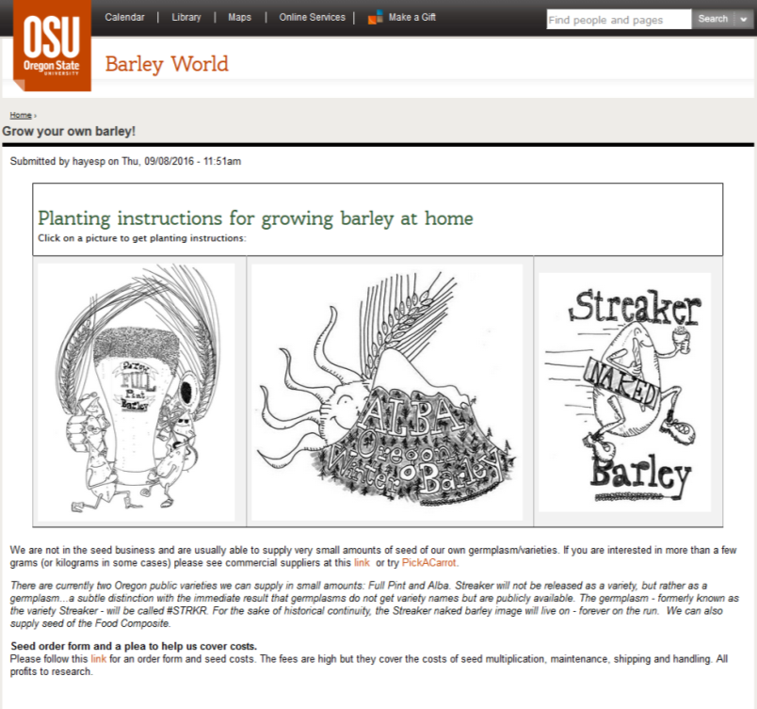
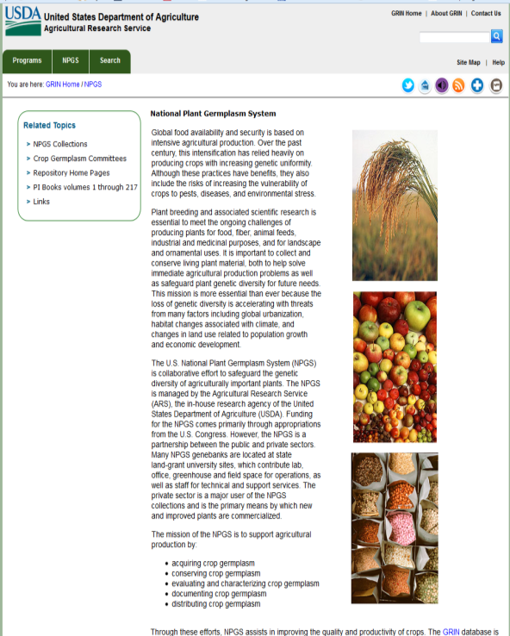
What barley to grow?
Why not take a walk on the wilder side?

Slide 36
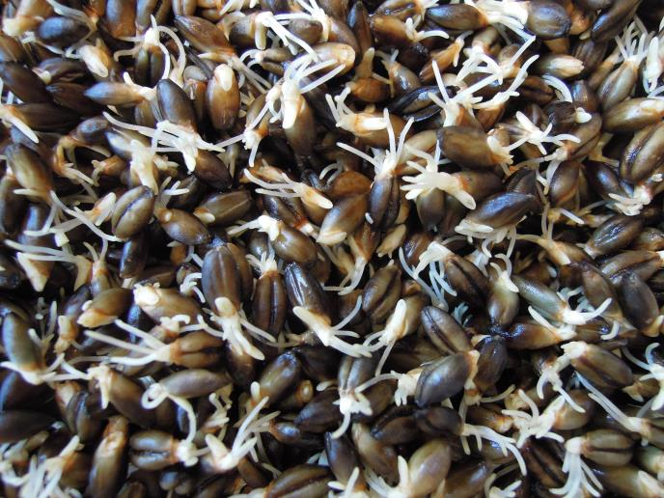
How (Malting)
Steeping
Germination
Kilning
Time (~1 week)
temperature (50º – 350º)
Moisture (10% – 50%)

Slide 37
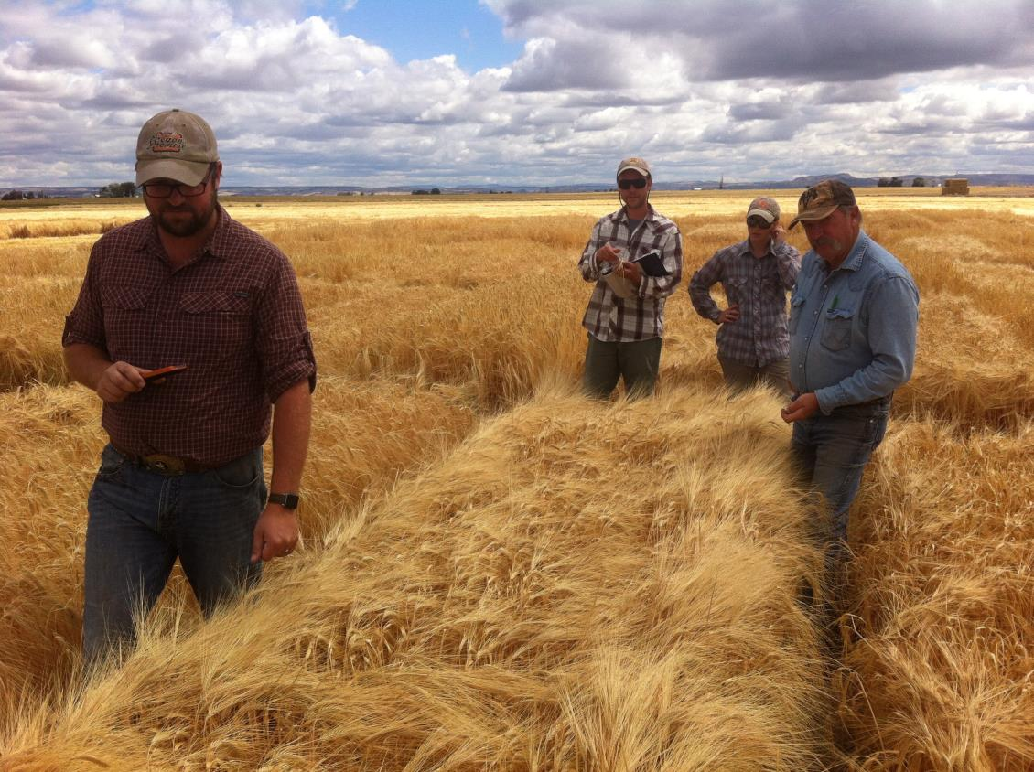
Malting!!!!!
Seth Klann and Mecca Grade Estate Malt

Slide 38
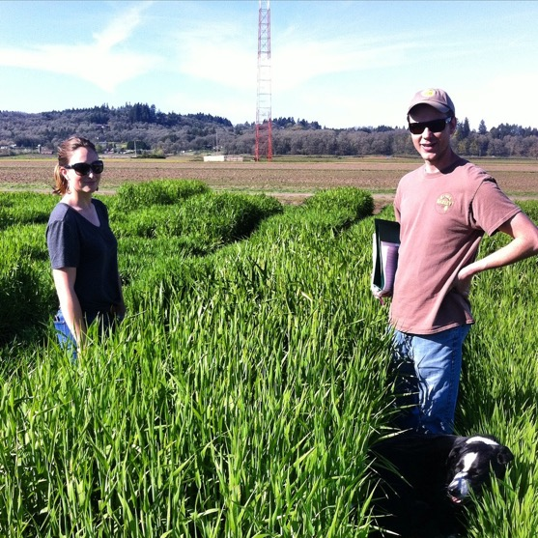
Thanks!
The Oregon Barley Project crew – past and present
Joel Rea and Crew for the Full Pint Beers
Brought to you by
Your Oregon tax dollars, Federal grants, American Malting Barley Association, Brewers Association, Great Western Malting, The Flavor-Pack, Mecca Grade Estate Malt, Oregon Wheat Commission

