Slide 1
The Perfect Pairing (or how I learned to stop analyzing and drink the damn beer) Tips, Tricks and Techniques for Pairing Food and Beer
Presented by
Andrew Reudink

Slide 2
“Those who drink beer will think beer”

Slide 3
Qualitative v. Quantitative

Slide 4
True or False?
Stout is the best beer to pair with oysters on the half shell?
Neither or Both
It’s subjective…

Slide 5
The Basics - Dinner What to drink with what you are eating.
Notes:
This is pairing in its simplest form.
My Meal is ready – What to drink with what I’m eating?

Slide 6
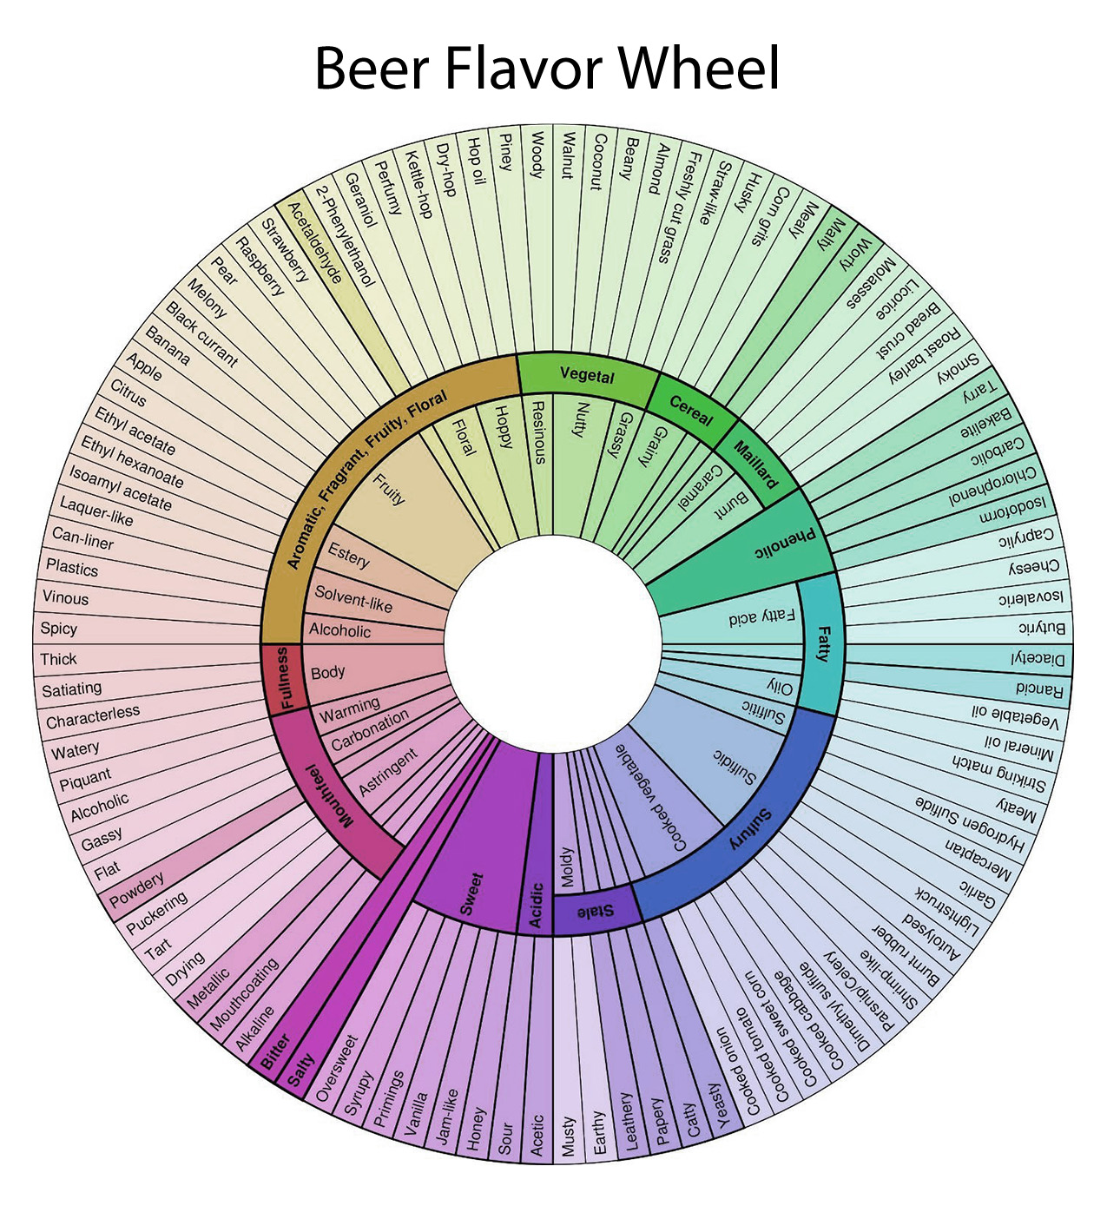
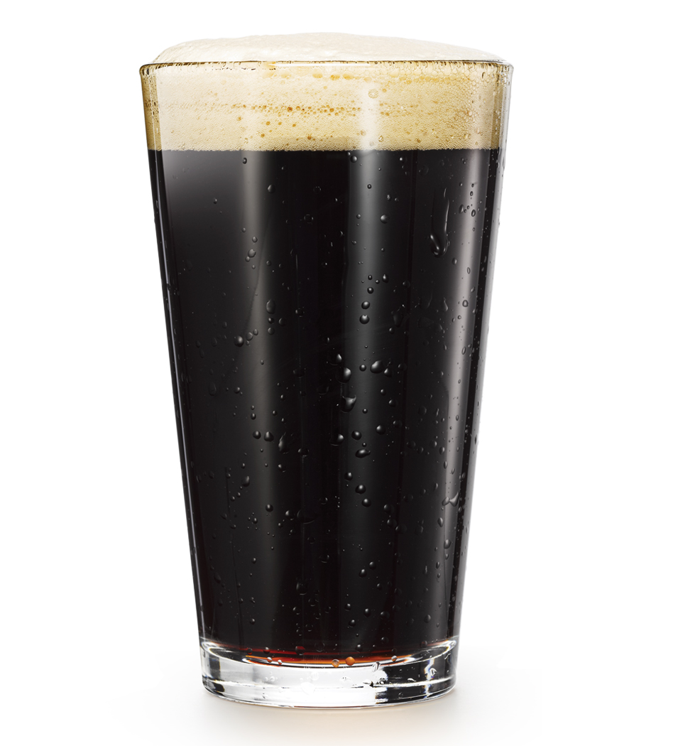

Slide 7
Combining Flavors Let’s start with dessert, shall we? Say, chocolate cake.
More is More
Opposites Attract
Barrel Aged Imperial Milk Stout infused with coffee and cacao
Nut Brown Ale
Framboise
English Barleywine
Berlinerweisse
Lambic or Kriek
Gose
Blonde

Slide 8
A Brewer’s Dinner at Home What to eat with what you brew.
Aim for a party of six to eight people.

Slide 9
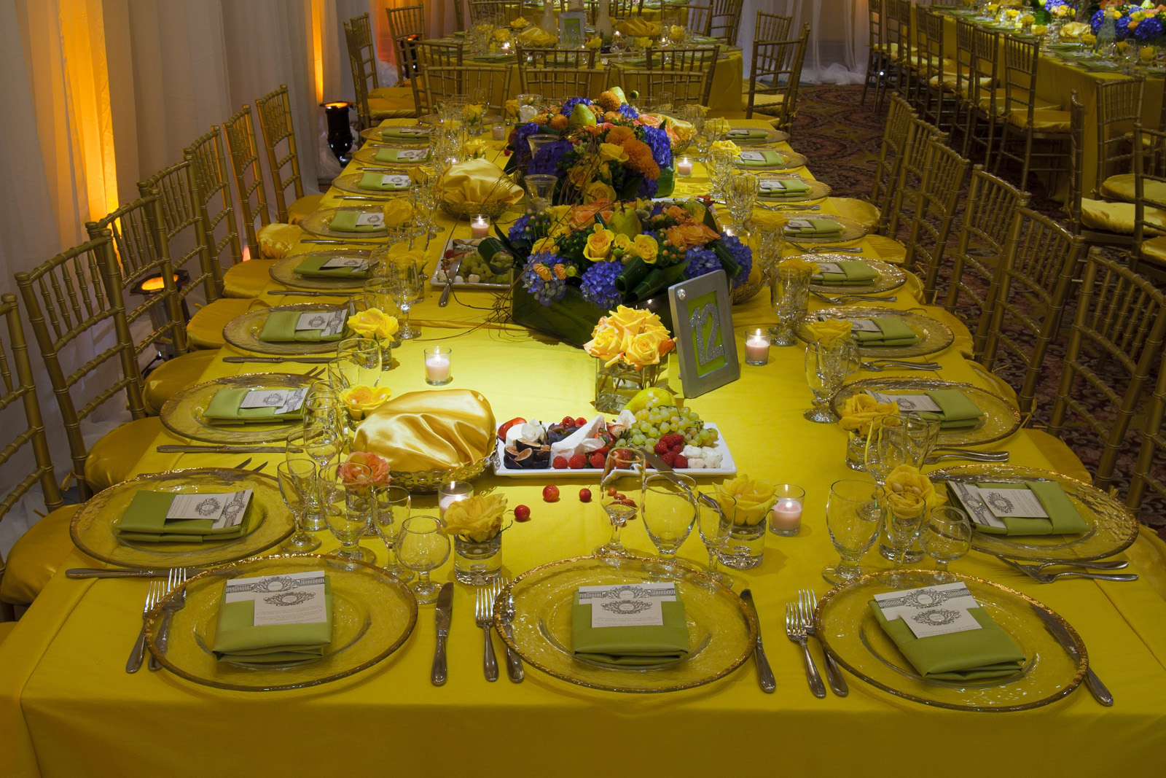

Slide 10
Being a good host
Be Prepared! do lots of “research”
Be flexible - mistakes happen, role with it
Tell the story of your tasting – explain selections
Serve responsibly – more beers? shorter pours
Engage with your guests – enjoy the culmination of all your efforts

Slide 11
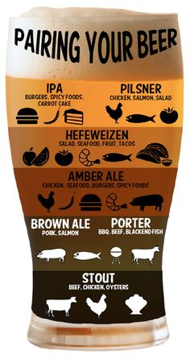
Discussion
Can I eat thin mints with IPA?
Should I put Rauchbier in my alfredo sauce?
Will Hefeweizen pair well with street tacos?
Won’t my neighbors see the empties and think I’m a lush?

Slide 12
Thanks for attending!
Also, Door Prizes

