Slide 1
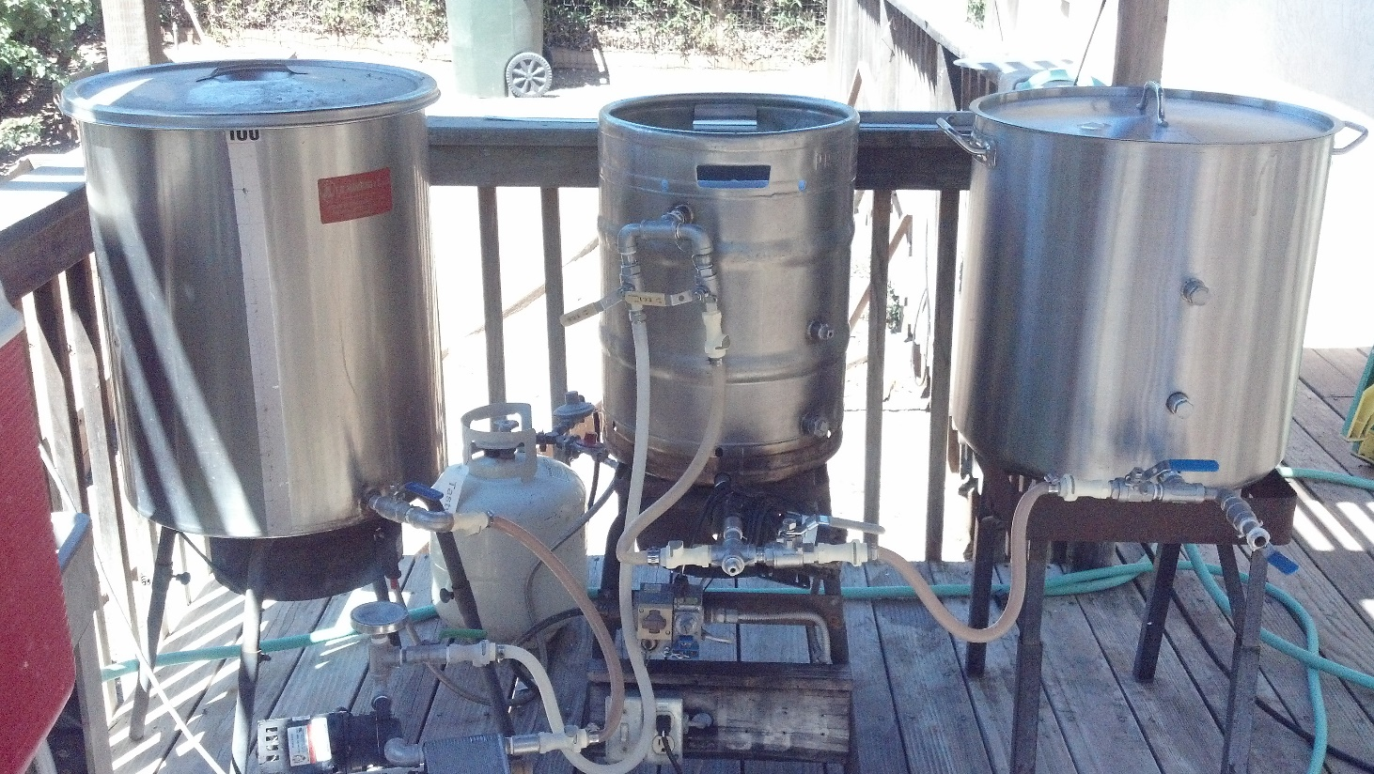
Brewing Consistency
Identifying and Controlling the Variables
Mike “Tasty” McDole

Slide 2
Why is brewing consistency important?
Make the recipe matter
It’s the master plan
Part of the record
Clone commercial beers
Create a sharable recipe
Beer repeatability
Beer quality
Detect the effect of hardware/process changes

Slide 3
Variables to control.
Ingredients
Water
Malt
Hops
Yeast
Process
Milling
Mashing
Sparging
Boiling
Hop additions
Whirlpool
Knockout
Fermentation
Cellaring

Slide 4
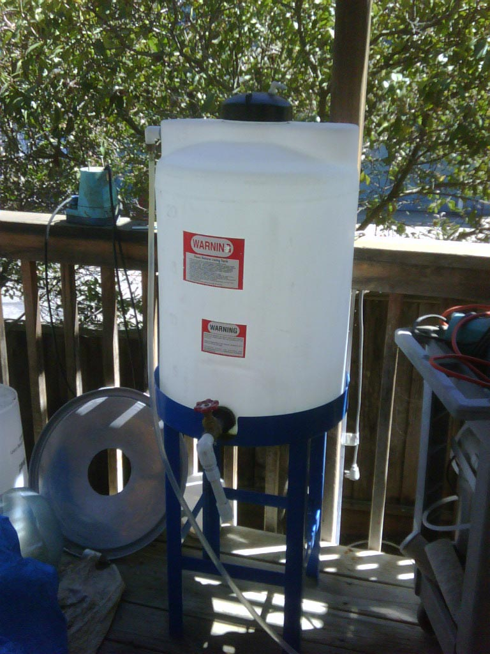
Ingredients - Water
Beer is over 90% water
Consistently good tasting water
Chlorine removal
Water Report
Hardness – Salt Additions
Dilution
RO

Slide 5
Ingredients - Malt
Freshest possible
Highest quality
If possible, check your potential extract

Slide 6
Ingredients - Hops
Know your alpha
Freshest possible
Buy in bulk
Store correctly

Slide 7
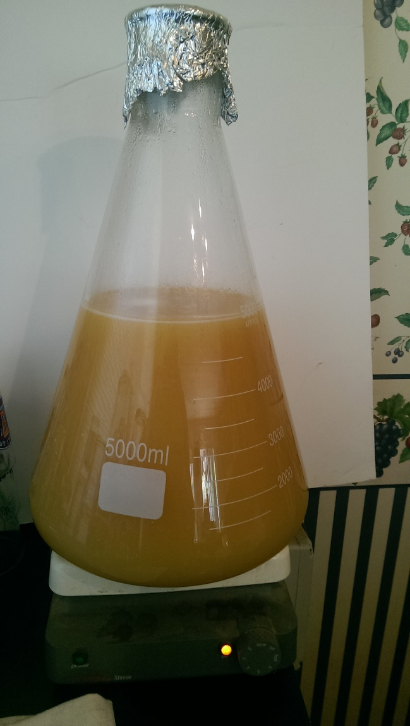
Ingredients- Yeast
Starter
Active
Oxygenated
Appropriately sized
Consistent cell count

Slide 8
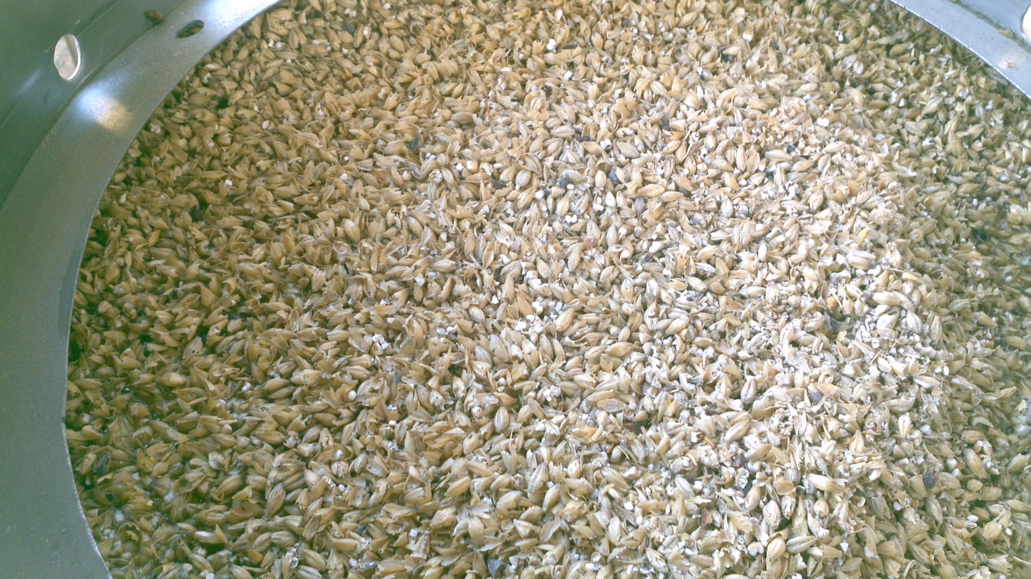
Process - Milling
Consistency
Lauterability

Slide 9
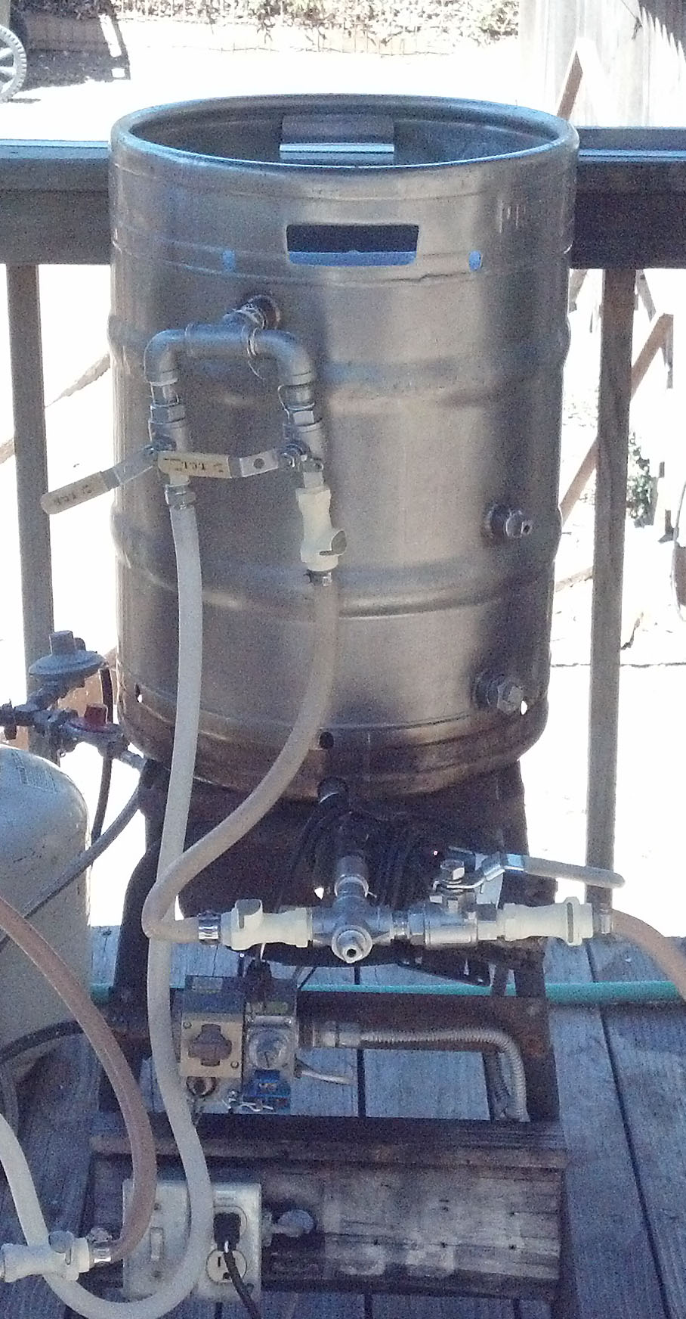
Process - Mashing
Dough-In
Strike Temperature
Grist Temperature
Water-Grist Ratio
Temperature Control
Ph
Vorlauf

Slide 10
Process - Sparging
Runoff Rate
Consistent
Checking it

Slide 11
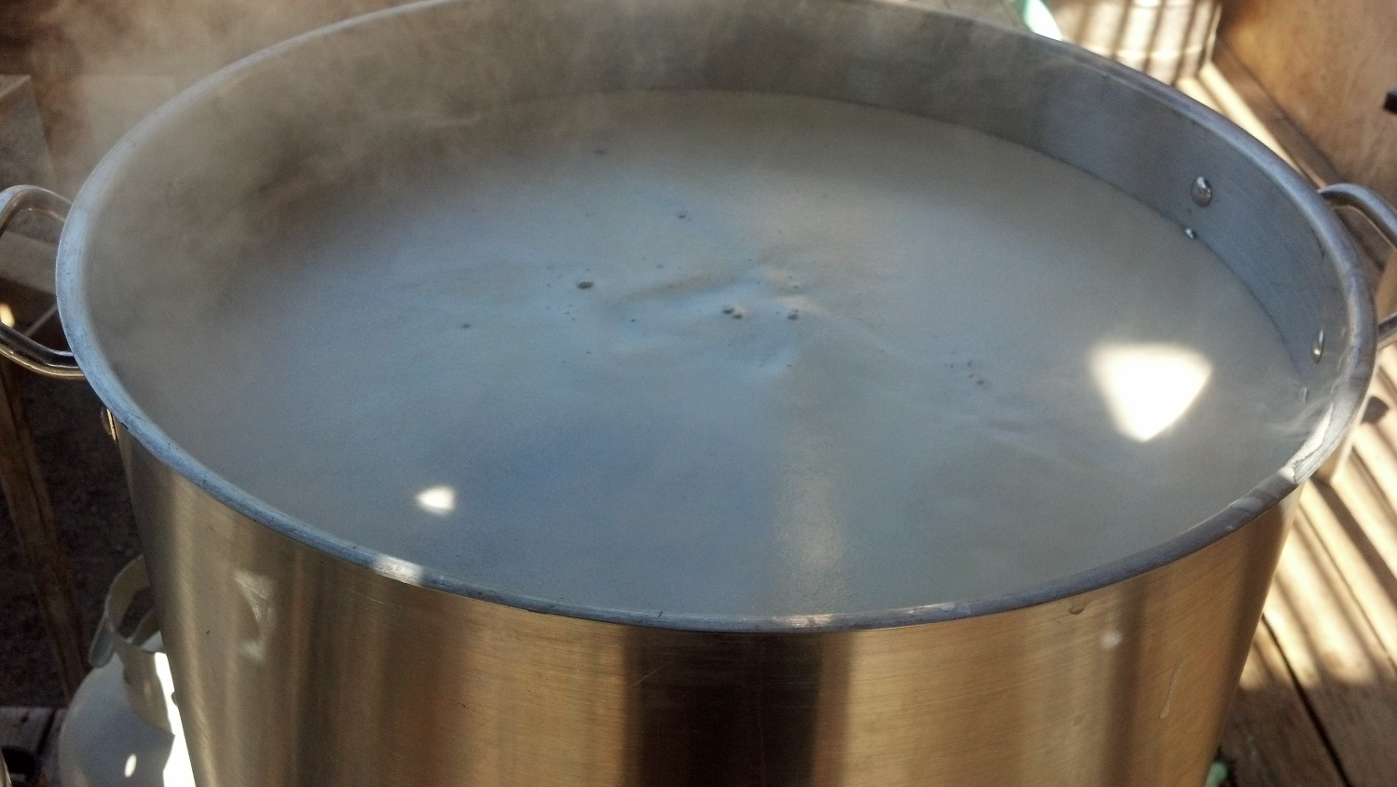
Process - Boiling
Boil Off Rate
Burner Rating
Ambient Conditions
Pre-Boil Gravity
When it’s low
Boil until it’s right (make less beer)
Add Malt Extract/Sugar
Make a different beer
When it’s high
Add water
Make more beer or reduce volume
Make a different beer

Slide 12
Process – Hop Additions
Stick to the recipe
Loose are bagged

Slide 13
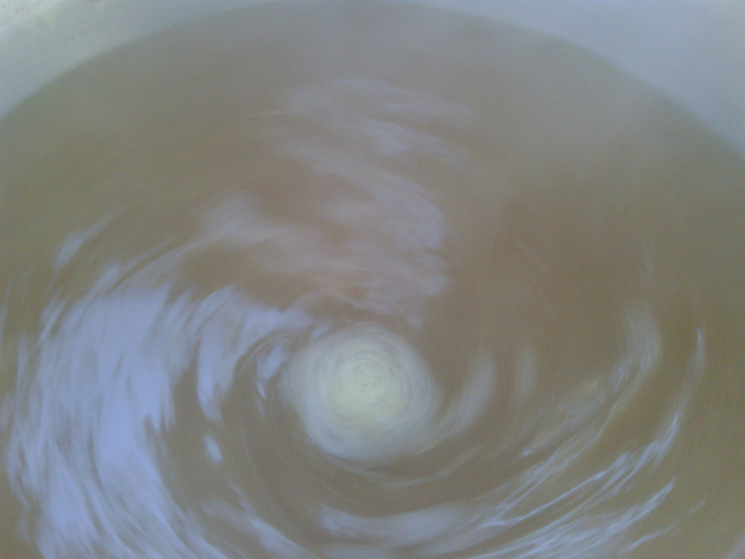
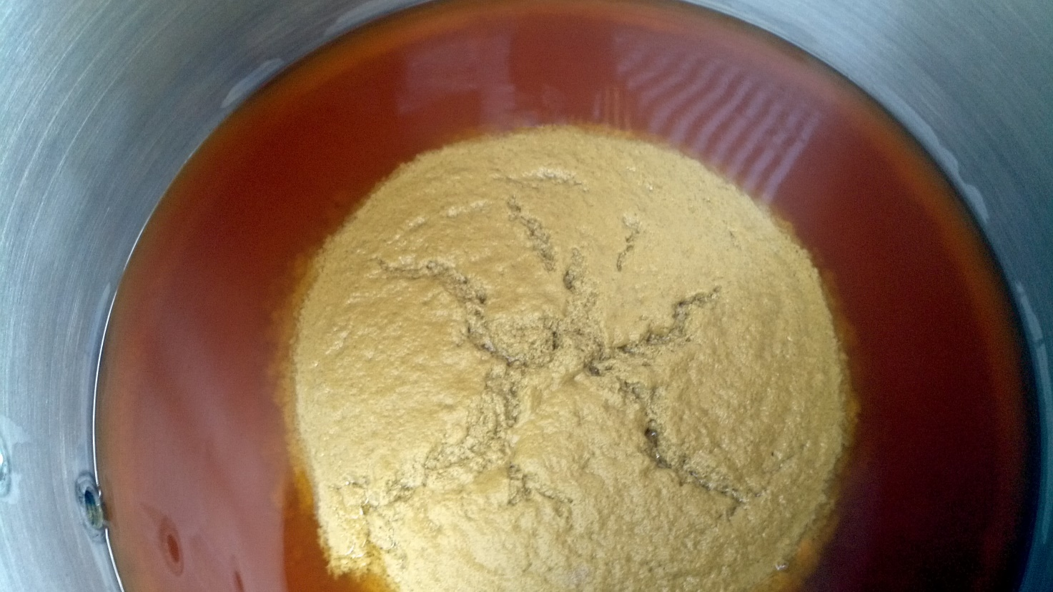
Process - Whirlpool
Length
Effectiveness

Slide 14
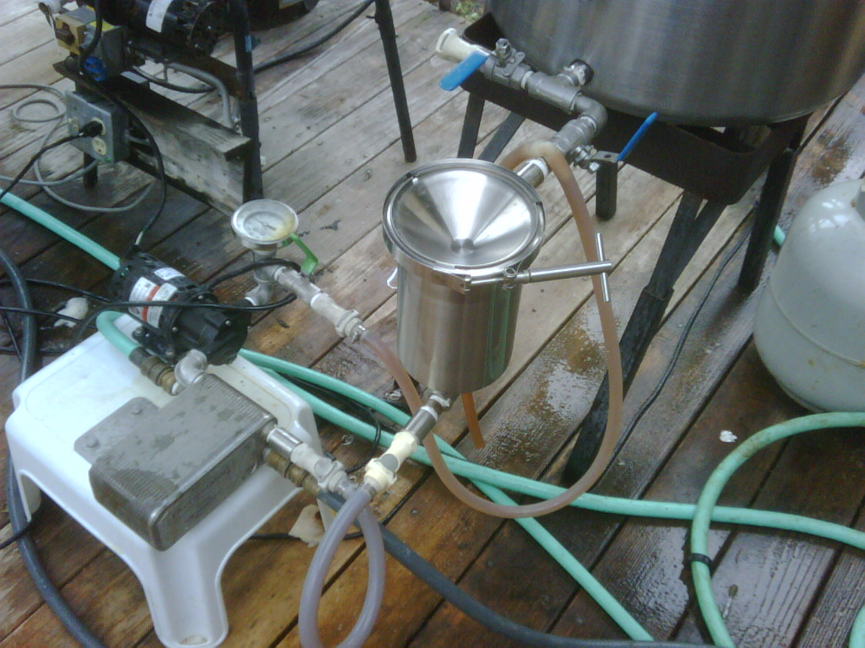
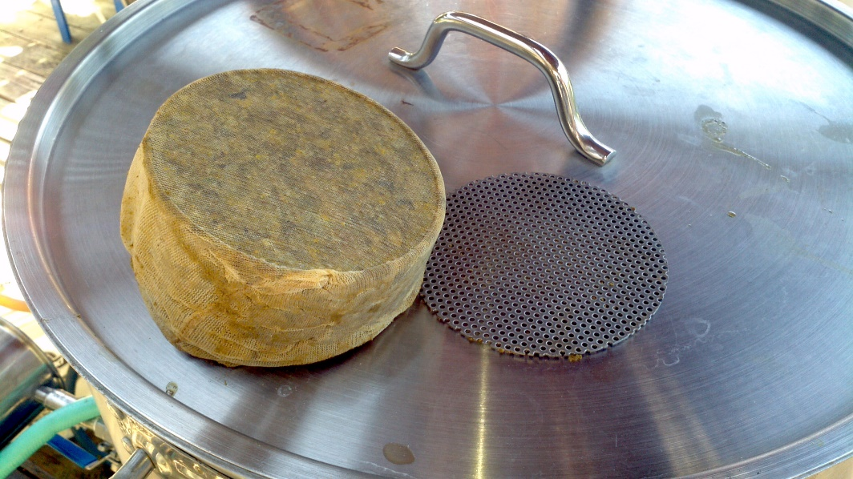
Process - Knockout
Length
Temperature

Slide 15
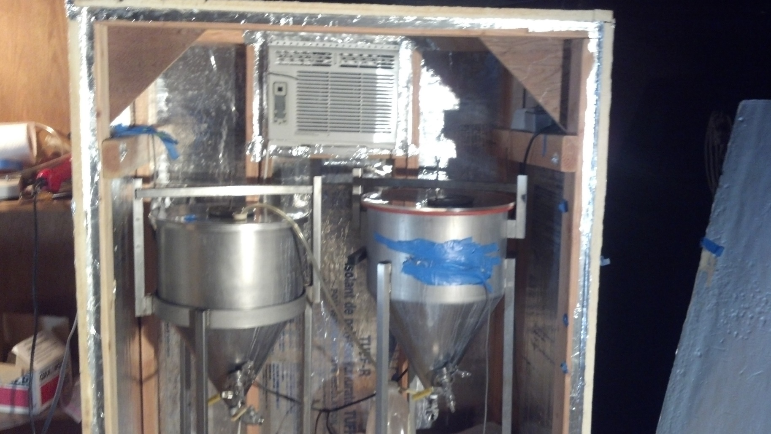
Process Fermentation
Oxygenation
Temperature Control
Documented profile

Slide 16
Cellaring
Beer is meant to be clear
Conditioning
Treat it like milk

Slide 17
The End
Questions?

Slide 19
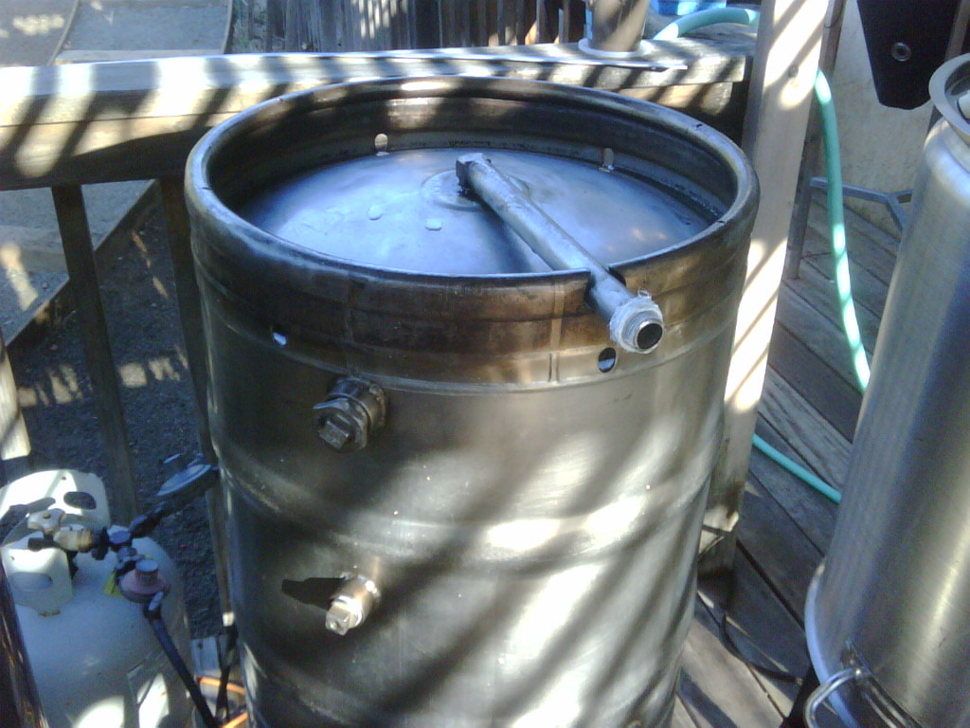
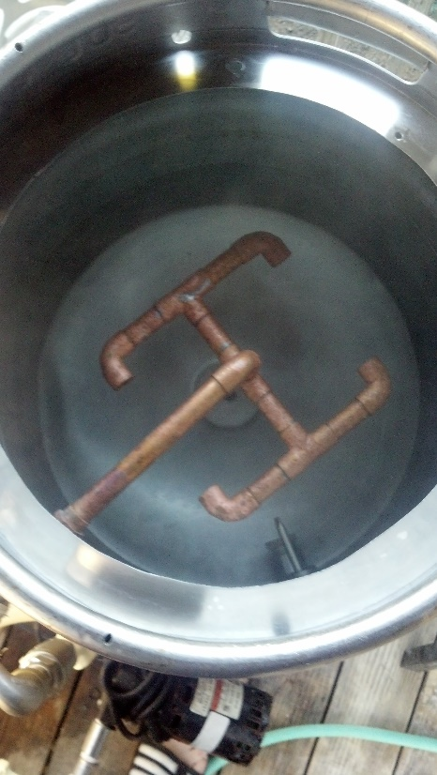
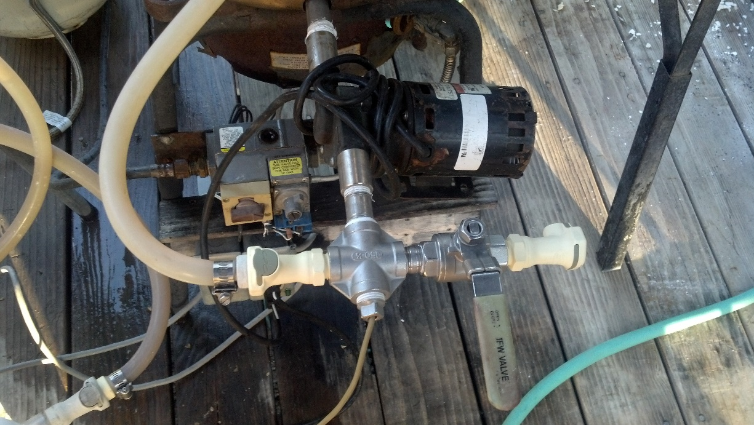

Slide 20
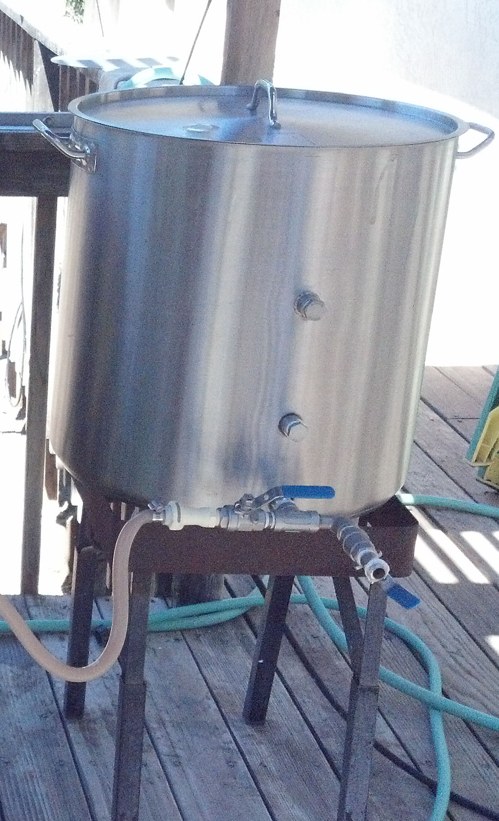
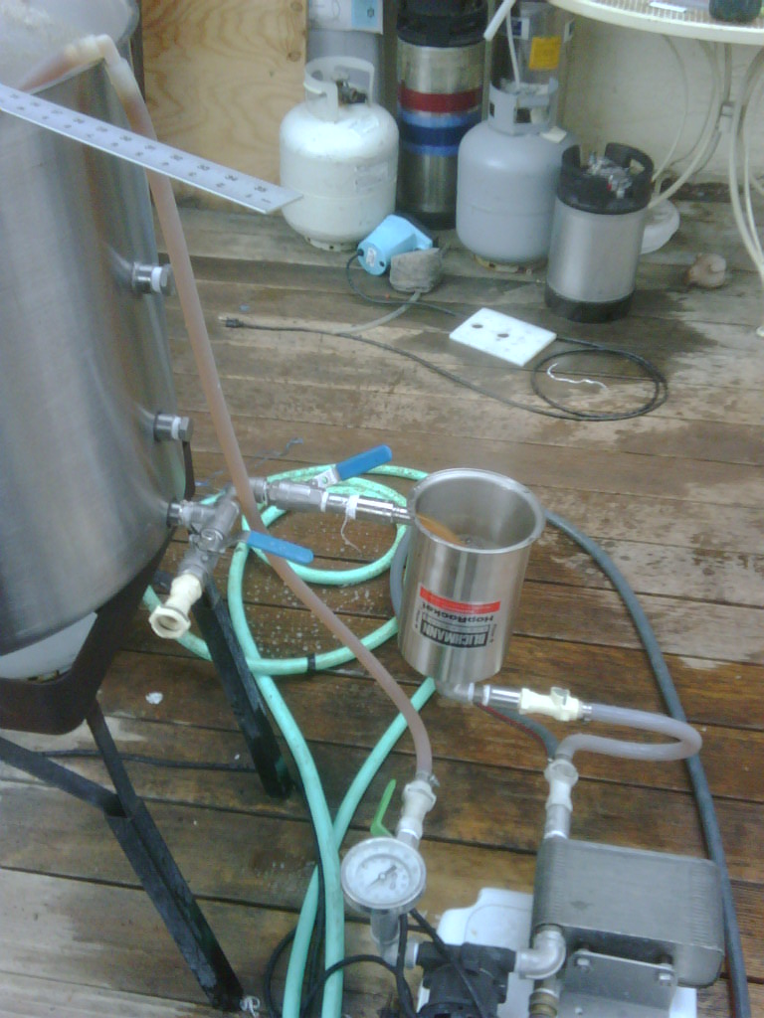

Slide 21
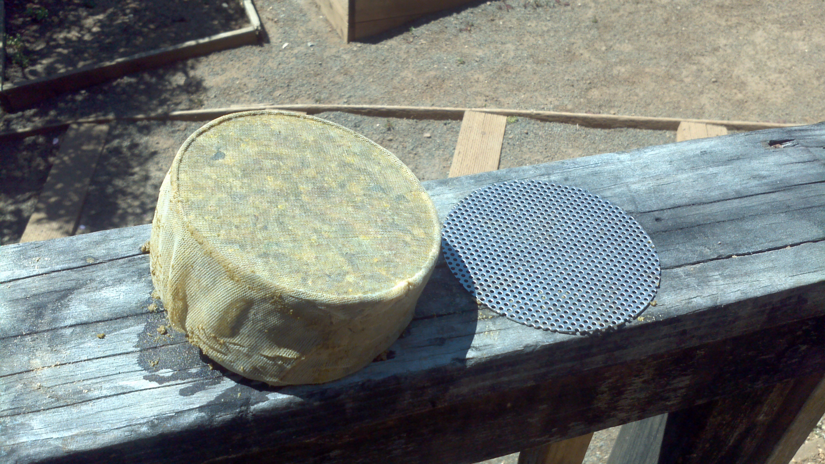

Slide 22
