Slide 1
Brewing up a Business
Prof. Mellie Pullman
Business of Craft Brewing Program
Portland State University

Slide 2
Thinking about going into a brewery business?
Competitive environment
Fallout
Opportunities

Slide 3
Competitive Environment
More than 5000 Craft Breweries (up ~750 since 2015)
Volume growth dipped to single digit 8% in 2016 (first half)
Sales growth at roughly 6% for same period
Local brewery growth from 2015 to 2016
Oregon 206 to 230
Washington 274 to 351

Slide 4
Concept SalesTrends
On-premise growth (+)
Taprooms
Brewpubs
Higher profit margin
Addresses buying local preferences
Off-premise (-)
Less % of overall profit
Highly competitive with 1000s of SKUs
Big players with big money controlling shelves
Price war pressure

Slide 5
Where are the margins (Price-COGS)?
Wholesale kegs
$60 – 80/keg
Wholesale Cases
$160-190/keg equivalent
On-site Pints/Growlers
$400 – 500/keg

Slide 6
Other Financial Factors
Capital and Operating Costs
Equipment
Other Startup Costs
Monthly Overhead
Cash flow
What money is available each month to pay for things?
Spending too much money on capital investments and inventory means not enough money to
pay people
Promote and expand market

Slide 7
Equipment
3 - 5 bbl $50,000 to $75,000 new
15 bbl $200,000 and up
Packaging $ 40,000 used; $120,000 + new

Slide 8
Other Startup costs
Construction and salaries before production $50,000 to millions
Licensing and one time legal fees $15,000 to $30,000
Cash for operations $100,000 to ???
Total Startup with equipment $250,000 (used and volunteers) to $ 600,000 and more!

Slide 9
Other Overhead (Variable)
Monthly costs example
Rent $2000
Utilities $1000
Insurance, legal, accounting $1000
Marketing, Management & Labor costs $12,000
Maintenance $1,000
Total cost/month $17,000
Total Cost/year $204,000

Slide 10
Casualties

Slide 11
OR/WA Breweries that closed in 2016
Southern Oregon
Humble Brewing
Fire Mountain Brewhouse
Buckman Botanical
Hard Knocks
Twisted Snout

Slide 12
Reasons
Town too small to support a brewery
Landlord kicked out tenants
City problems
Weak brands: Violent names on beers or owner inside jokes that don’t resonate with consumers in PAC NW
Political conflicts on social media

Slide 13
Who is the brand offending?

Slide 14
Other Reasons
Too small and not enough cash or space to expand
Over-reliance on distribution (rather than taproom)
Pressure from big money competition
Over-reliance on a fixed line-up without new innovations (seasonals)

Slide 15
Breweries for Sale
BTU Brasserie (7BBL)
Amnesia (15 BBL)
Deception (4 BBL)
Bunsenbrewer
Oregon Trail (7 BBL)

Slide 16
Reasons for selling
Great food, mediocre beers, and loss of buzz
Relocation to a location with less traffic
(N. Mississippi to Washougal)
Competition from wineries in area
Too many family obligations

Slide 17
Valiant Brewing: Orange County
Will close this month
Open for 4 years
Great team
Solid product

Slide 18
Reasons
Too much money spent on facility and equipment (20 BBL)
Owners wanted to maintain control and not bring in investors
No money left to advance or pay themselves

Slide 19
Key Issues
Personal
Family
Financial
Strategy
Quality
Brand
Size
Location
Personal Views

Slide 20
Newest big Startups
Washington and Oregon

Slide 21
Wayfinder (Portland)
Brewpub (nice food)
Solid branding and differentiation
Ample cash
Perfect location
Underserved
Enough traffic
Right Sizing
10 BBL Brewhouse
Scale to larger when needed

Slide 22
Hopworks (Vancouver)
8 BBL Brewhouse
Proven pub formula from Hopworks PDX
Seating for 300
Supply additional beer needs from Portland Brewery

Slide 23
Common Themes
Small brew house
Wide variety of drinks and food
Industry Veterans
Big investment in high quality spaces
Food Focus
Neighborhood focus

Slide 24
What we need now
People with skills to professionalize industry
It’s fun to make beer but you need to live,
It’s not just a hobby, it’s a business.

Slide 25
Needed Skills
Working in the industry
Brewing (solid technical skills)
Supply Chain & Operations Management
Marketing
Branding
Social Media
Data Analytics
Technical Brewing Schools
American Brewers Guild or Siebel (Online)
Local Brewing Programs
Brewery Business Certificates (short/focused)
General Brewery Business (PSU & UP)
Supply Chain Management
Data Analytics

Slide 26
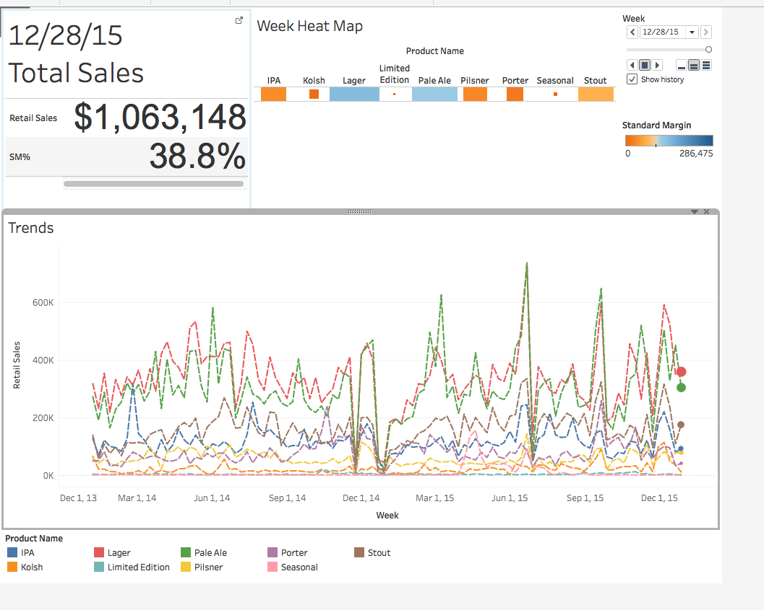

Slide 27
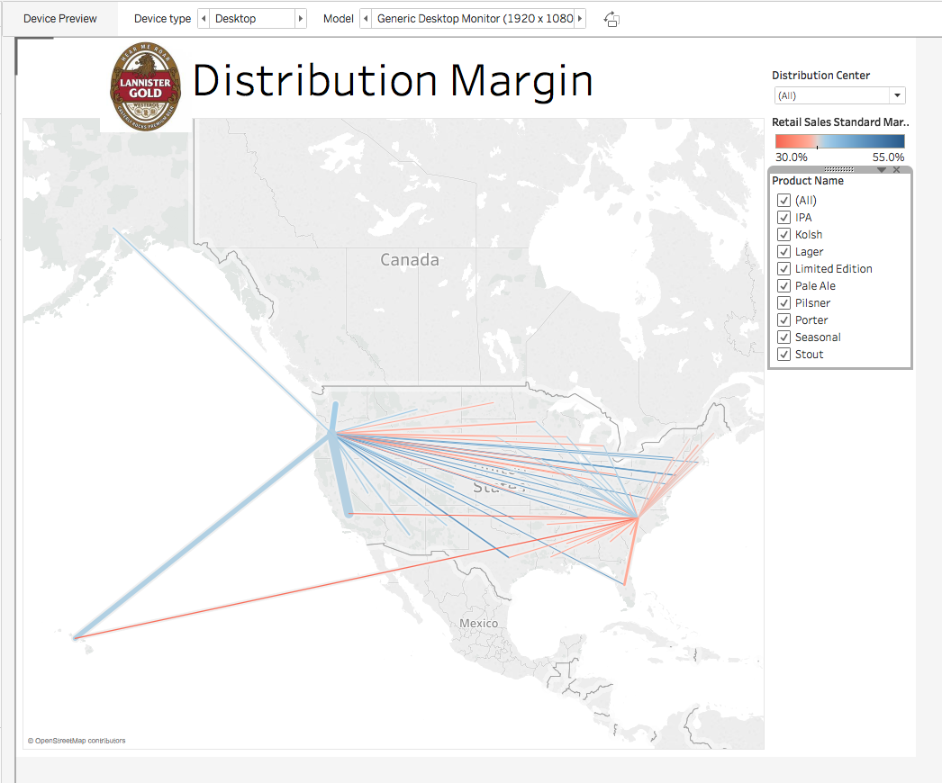

Slide 28
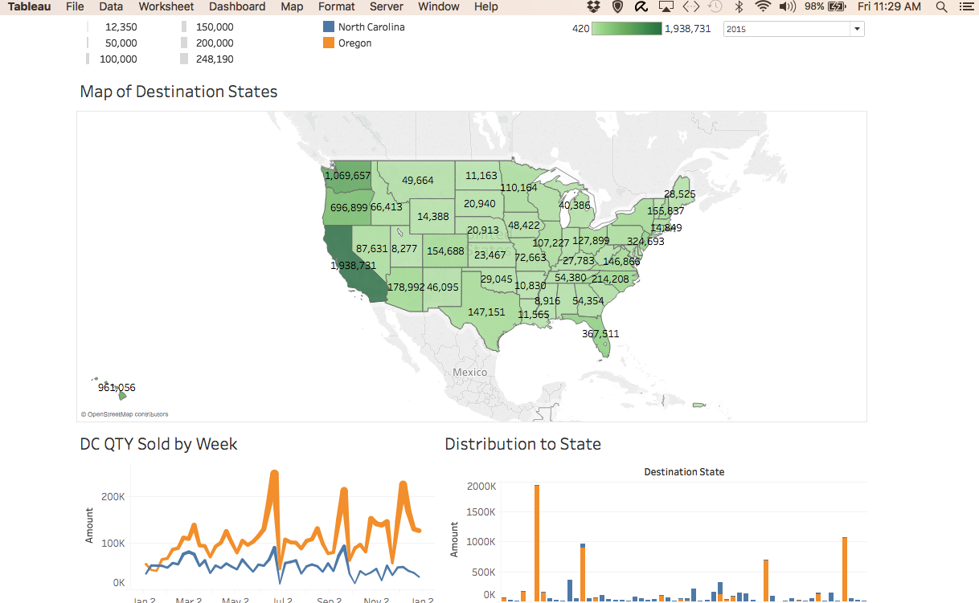

Slide 29
Any Questions?
Thanks!

Slide 30
Mellie Pullman mpullman@pdx.edu
Contact info:

