Slide 1
How to Brew Like an All-Star
A Lesson in Life, Jung and Brew

Slide 2
We’re Sorry, But We’re Required to Do This….
(see the 1978 Federal Omnibus Bill for more details)

Slide 3
Sing Along… (What? It’s For Science!)
It’s Just About Time…
It’s Just About Time…
Don’tcha Think It’s Bout Time
We Talked About Beer?
So Come On In…Come On In.. Just Come On In
Pour Yourself a Beer
Beer, Beer, Beer, Beer… x4

Slide 4
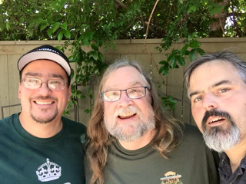

Slide 5
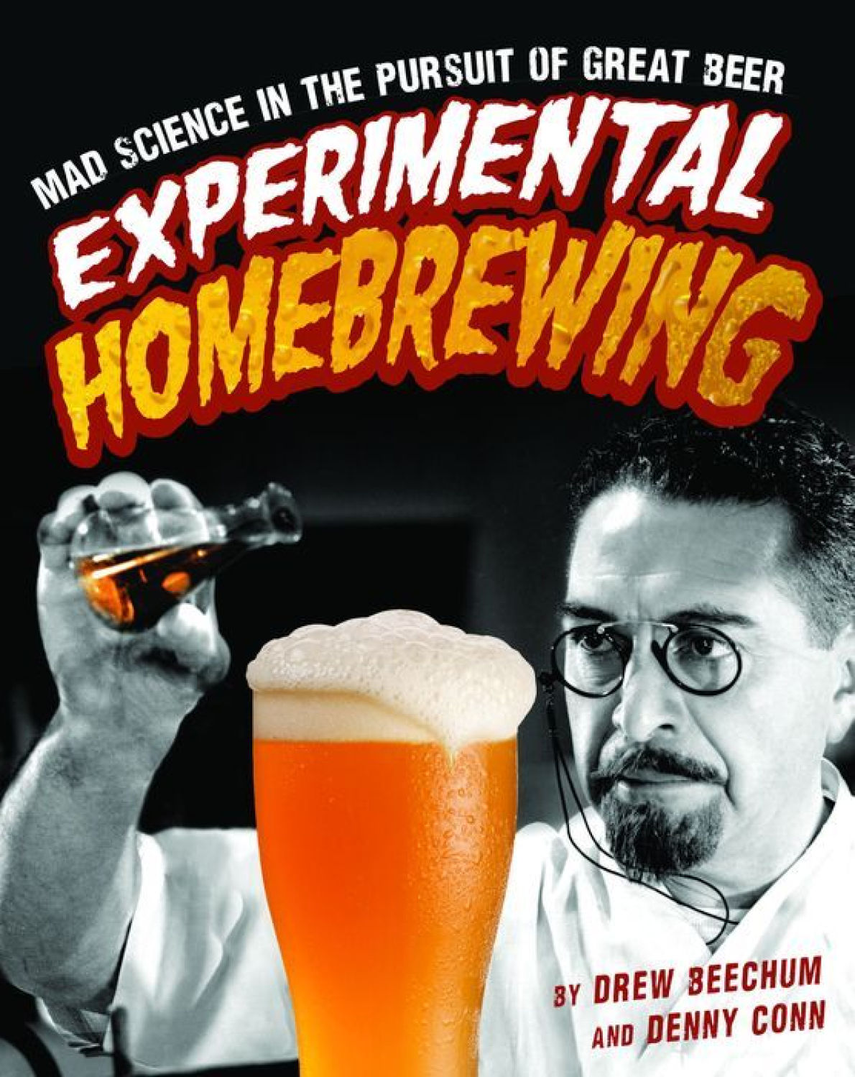
Time To Get the Commercial out of the Way
Apparently We Have “Issues” – It Happens After 40 Years of Steaming Hop Facials
Two Books – Experimental Homebrewing and Homebrew All-Stars
One Bi-Weekly Podcast – Experimental Brewing

Slide 6
What Do We Mean By An All-Star?
Not Just Medals/Ribbons/Awards
Sure that’s always a cool thing…
Teaches
Have a lesson to teach and share (Friendly like)
Innovates
Be willing to adapt/adopt/extend
Supports Others
Community Needs Your Help!
And….

Slide 7
The Most Important…
Brew.
Seems simple doesn’t it, but more experience tends to slow down brewing
So find new ways to make it fun
Quick Show of Hands:
How many of you have been brewing 1 year? 2? 5? 10?
How many of you brew at least: Once a year? 3 times? Every other month? Monthly? Every other week?
How many of you have tried a new technique/style/ingredient in the last 4 batches of beer?

Slide 8
Our All-Star Experiences
Drew:
Started out in 1999
Brewed over 20 batches with others
At Their Houses, With Their Gear
Learning Their Techniques (both good and ill)
Denny:
Started in 1998
Not Near Other Brewers
rec.crafts.brewing, HBD mailing list and Other Online Resources
Show of Hands
How many of You Brew with Others?
How many of you primarily experience brewing “online”?

Slide 9
Everest Level Overview of Homebrewers
Survey with 600 takers, so take this with a grain of salt…
Average homebrewer from our survey:
Has survived to the ripe old age of 30-39 (Avg. 34)
Works in a Technical Field (43.4% - 18.8% in IT)
Graduated College or Beyond (75.2%)
We didn’t ask Gender/Race but the AHA’s Surveys says
94% Male / 78% Married
88% White European descent

Slide 10
We totally forgot to ask about…
But Why Ask the Obvious?

Slide 11
The Mega List of “All Star Tips”
Clean as you go. It’ll make life a lot easier at the end of a long brew day.
Sanitize, sanitize, sanitize! Don’t waste your brew day effort by lazing out.
Treat yeast right! Better Yeast Health Means Better Beer
Temperature control, at least for the first seventy-two hours, will really step up your brew quality
All the fancy equipment in the world isn’t going to make your beer better, but it might be fun to have.
Take good notes.
Have fun and don’t stress out! This is a hobby, and malted barley wants to become beer!
Maybe hold off on the beer until you’re well on your way to brew day success
You need to play around. Embrace your fear of failing. It’s only beer! You can always brew more.

Slide 12
A Pop-Psychology Primer
Time to break out your psychoanalysis…
It’s Jung Time!
C.G. Jung (1875-1961)
Responsible for many modern psychological concepts
100% Responsible for all the “Which Hobbit Are You?” Quizzes

Slide 13
What’s All This About Jung?
Among Jung’s key concepts are “Archetypes”
Fundamental underlying programming types for a species
Adopted into modern culture as specific “images”
Great Mother/Father
The Trickster
The Maiden, etc, etc.
Used in popular culture, marketing, movies, etc.
Naturally, we’re doing something stupid with it.

Slide 14
Why Bother With Archetypes?
We think it’s important to understand the type of brewer you are.
Aids in helping explain where your natural strengths and weaknesses lie.
Plus, let’s face it – we’re hoping it becomes the brewer’s equivalent of the Zodiac –
“Hey buddy? What’s your sign”
“That’s such a Old School Master thing to say/brew”

Slide 15
How to Score Your Quiz
Let’s see how you did. To learn your brewing archetype, simply add up the ranks you gave to each of the
A/B/C/D responses. Your strongest affinity is for the letter with the lowest total score.
Here’s how the archetypes fit into the responses.
The Recipe (and Ingredient) Innovator
The Scientist / Process Nut
The Old-School Master (Traditionalist)
The Wild One
In other words, let’s say Drew took this quiz – his scores would look something like this:
Answer | Q1 | Q2 | Q3 | Q4 | Q5 | Q6 | Q7 | Q8 | Q9 | Q10
A | 1 | 1 | 1 | 1 | 2 | 1 | 1 | 1 | 1 | 1
B | 3 | 2 | 4 | 3 | 3 | 2 | 4 | 4 | 2 | 4
C | 4 | 4 | 3 | 4 | 4 | 3 | 3 | 3 | 4 | 3
D | 2 | 3 | 2 | 2 | 1 | 4 | 2 | 2 | 3 | 2
A:10
B: 31
C: 35
D: 23

Slide 16
Questions – Keep Score At Home
It’s 2 a.m. on a sleepless night. To lull myself to sleep, I begin to think about my next brew day.
A. That blot of mustard on my shirt from earlier tonight reminds me: a mustard beer would be interesting to try.
B. Hmm, which malt and hop should I use in my next SMaSH beer?
C. I should brew an English barleywine so I’m ready for Christmas.
D. When do the fruit orchards begin to bloom this year?

Slide 17
Questions – Keep Score At Home
Where are you when inspiration strikes you for your next batch of beer?
A. At your local micro flour mill discovering they have Tibetan Purple Barley (or reading online about Neo-Mexicanus hops or wanting to now that you’ve heard the name)
B. Flipping through the pages of Cynmar or AS&S’s latest catalog
C. Your local English pub
D. Watching a documentary on the bee men of Africa

Slide 18
Questions – Keep Score At Home
In order of importance, rank these elements in terms of your brewing priorities (1 being the highest priority and 4 being the lowest):
A. Developing a beer that makes people go “wha?”
B. Dialing in on my process
C. Using traditional techniques to make perfect beer
D. Coaxing complex characters from multiple microorganisms

Slide 19
Questions – Keep Score At Home
When you sit down with a glass of beer, what are you looking for on the first sip?
A. A flavor that makes you think, “How did they do this?”
B. A beer that tastes just like the last one you had from this brewery
C. A reassuring blend of familiar flavors
D. Something so sour you make a scrunchy face

Slide 20
Questions – Keep Score At Home
Imagine yourself in the plumbing department of a large home improvement store. As you peruse the aisles, what are you thinking?
A. I don’t know what that thing is, but I need it!
B. How would that affect my mash runoff?
C. That’s just like the valve I saw in a picture of a German brewery.
D. I could use that to make a separate fermenter for my wild beers.

Slide 21
How Did You Do?
Add up your points!
How many of you are:
(A) Recipe Innovators?
(B) Scientist / Process Nerd?
(C) Old School?
(D) Wild Ones?

Slide 22
But I’m Not Just A <blank>!
“Do I contradict myself?
Very well, then I contradict myself,
(I am large,
I contain multitudes.)”
- Song of Myself - Walt Whitman

Slide 23
The Old School Master
Tradition is the key word
Eschews “crazy” in favor of “purity”
Just had a big sausage and beer party in honor of the Reinheitsgebot’s 500th anniversary.
How many of you know an OSM?

Slide 24
OSM: The Good and The Bad
The Good
Passionate – arguably the most
Depth of knowledge about their field
Preserve the knowledge of the past
The Bad
Tunnel Vision
Lack of Flexibility

Slide 25
OSM: What We Can Learn
Lars Marius Garshol
The Alan Lomax of Historical Beer
Because Lars considers himself more of a researcher than a homebrewer, he brews with friends in a traditional brewery or with homebrewers in their houses, using their equipment. His interest lies in the process and results. “When I brew I typically try to reproduce some traditional beer to understand the process and how it works. So the process is always different, since the traditional brewing processes vary dramatically.” But who says tradition is boring? When brewing with a traditional homebrewer in Voss, Norway, Lars co-created a beer with a yeast strain inherited from the brewer’s uncle and a huge 300-liter copper kettle from the eighteenth century. Now, he’s trying to crack the code on a Hornindal-style recipe for “raw ale” (a.k.a. unboiled beer).

Slide 26
OSM Recipe: Annie Johnson This Budvar is For You
For 5.5 gallons, 1.051, 43 IBUs, 5.25%ABV
Malt
11.0 lbs Pilsner
0.33 lbs Sauer Malt
Mash
Rests at 99F / 102F / 140F / 149F / 170F
Hops
1.5 oz. Czech Saaz 3.5% AA
@ 60 / 30 / 10 / 0 minutes
Yeast
WLP802 Czech Budejovice Lager

Slide 27
The Scientist / Process Nerd
This is Denny and others like Brulosopher Marshall
All About the “Science”
Prone to repetition

Slide 28
Scientists: The Good and The Bad
The Good
Driven by the desire “to know”
What they learn lays the groundwork for the rest of us
Process Repetition
The Bad
In the quest for knowledge, can miss the fun
Nerd Bludgeon

Slide 29
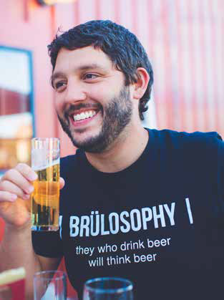
Scientists: What We Can Learn
Marshall Schott
Almost every batch he makes is an experiment in some way. One example: He made two 5-gallon batches of the same wort and beat the living hell out of one during all parts of the process prior to it being chilled, basically exposing it to as much air as possible, while the other was treated as gently as possible. He learned from this that hot-side aeration doesn’t appear to be something homebrewers need to worry much about.

Slide 30
Scientist Recipe: Denny Conn’s American Mild (Work in Progress)
For 5.5 gallons, 1.045, 45IBUs, 6.4%ABV
4.0 lbs Munich
2.0 lbs Pale Malt
1.0 lbs C60L
1.0 lbs Carapils
Single Infusion 148F for 60 minutes
Hops
0.25 oz Magnum 60 minutes
0.50 oz Cascade & Chinook 10 minutes
0.50 oz Columbus minutes
Yeast
Wyeast 1450 Denny’s Favorite

Slide 31
The Wild Ones

Slide 32
Wild Ones: The Good and The Bad
The Good
Patience
Creativity
Rolling the Dice
The Bad
Old Ways are “the One True Path”
Can Fall Prey to the “It’s Not Bad”
Out there can be a polite descriptor

Slide 33
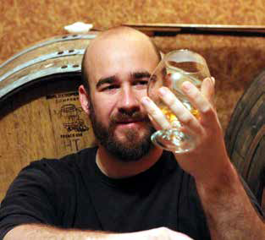
Wild Ones: What We Can Learn
Mike Tonsmiere
Have you ever wished your beer was more like a pet? If so, start a solera. The concept, borrowed from sherry producers, is to drain a portion of a batch off for packaging, then refill the fermenter. This creates a constantly evolving blend. It works especially well with sour beers, allowing a pull every six to twelve months of mature blended beer.
Add the beers to the barrel away from the club members. Here’s where having extra beer on hand is crucial: it means you can silently avoid adding any bad beer and still have enough to fill the barrel. If no one’s beer is bad, then you have enough beer to top up after evaporation. One advantage of this method is that everyone can happily believe their beer is in the blend and no one gets upset.

Slide 34
Wild One Recipe: Brandon Jones’ Dark Funk
For 5.5 gallons, 1.078, 42.6 IBUs
10.0 lbs Belgian Pale
1.5 lbs Munich 10L
0.5 lbs Special B
1.0 lbs Dark Candi Sugar
Single Infusion 150F for 60 minutes
Hops
0.5 oz EKG 5.2%AA 60 minutes
Yeast
WY3787 Trappist High Gravity WY3763 Roeselare or ECY02 Flemish Ale
WY5526 Brettanomyces lambicus
Extras
1 oz. Merlot French Oak Cubes (7 days)
6 oz. Black Currants (30 days)

Slide 35
The Recipe Innovator
No ingredient too weird.
No concept too out there to brew
This is Drew.. duh

Slide 36
Innovators: The Good and The Bad
The Good
Boundary pushing - Dissatisfied with the “quo”
Story tellers / Culinary minded
The Bad
Kid in the Candy Store Syndrome
Not Everything is a Great Idea
Course that varies on who you are – Clam Chowdah!
Hype Train Generators
“What’s wrong with beer flavored beer?”

Slide 37
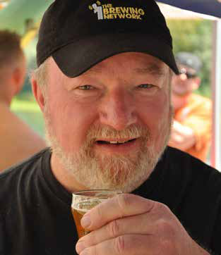
Innovators: What We Can Learn
Mike “Tasty” McDole
Mike has played with and refined what he considers the perfect fast lager schedule for us homebrewers. Here’s how Mike describes it: “I pitch and oxygenate at 55°F and hold until the gravity drops 50 percent of the way to terminal gravity. For example, if my OG is 1.052, and I expect to finish at about 1.010, then a drop of 21 gravity points would be 50 percent.) I then raise the fermentation temperature by three degrees to 58°F and hold until the gravity drops 75 percent of the way to terminal gravity. I then raise the fermentation temperature by 4 degrees to 62°F and hold until the gravity drops 90 percent of the way to terminal gravity. I then raise the fermentationte mperature by four degrees to 66°F and hold until I reach terminal gravity. With this method, 75 percent of the fermentation takes place at 58°F or below, 90 percent at 62°F or below.

Slide 38
Innovator Recipe: Saison Figolla
For 5.5 gallons, 1.057, 26 IBUs, 6.4%ABV
7.5 lbs Pilsner
1.75 lbs Munich
1.75 lbs Oat Malt
0.67 lbs Caravienne
0.67 lbs Biscuit
Single Infusion 148F for 60 minutes
Hops
3.3 oz Magnum 12.9% AA 60 minutes
2.0 oz Crystal 4.2%AA 5 minutes
Yeast
Wyeast 3711 French Sasion

Slide 39
The Gear Head
The “Lost” Type
They’re obsessed with the systems, the steel, the shiny pieces

Slide 40
Gear Heads: The Good and The Bad
The Good
Weavers of Practical Magic.
Always with a solution
Can recycle/upcycle anything into something useful
The Toys…
The Bad
Sometimes the gear is more important than the beer
Hoarding runs rampant in the brew shed
The tinkering can get in the way of the brew day

Slide 41
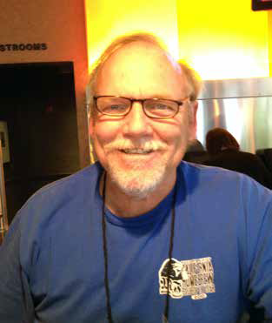
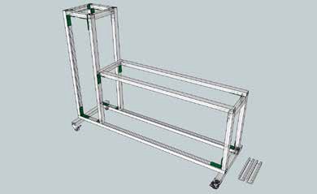
Gear Heads: What We Can Learn
Kent Fletcher
Want one of these?

Slide 42
Gear Head Recipe: Gary Glass’s Mia Wallace Maibock
For 5.25 gallons, 1.066, 36 IBUs, 7%ABV
8.5 lbs Pilsner
4.50 lbs Vienna malt
1.25 lbs American C15L
1.25 lbs Belgian Caramel Pils Malt
Rest (30 mins each) 127F / 148F / 156F
Mash out 177F for 10 minutes
Hops
0.65 oz Horizon 11%AA First Wort Hop
0.75 oz Horizon 11%AA 30 minutes
0.25 oz Horizon 11%AA 10 minutes
0.13 oz Horizon 11%AA 0 minutes
Yeast
Wyeast 2124 Bohemian Lager

Slide 43
Ways to Be An All-Star At Home
And no – it does mean trying to best Gordon Strong, Jamil Zainasheff and Mark Schoppe in the Ninkasi Award count…

Slide 44
Brew with Others
Invite Yourself Over to Others Breweries
You get more social activity
You can try new things
You can make things that are “special” (including stories)
A Brief Interlude on why Blood is a magical brewing ingredient
Invite Others to Brew With You
The same thing, but now in reverse
A Club Brew Day – “Brew with a Falcon”

Slide 45
Explore / Experiment
Break out of your rut.
New Technique?
New Ingredient?
New Style?
Heck – even just forcing yourself to explore a question
Aka – Citizen Science ala Experimental Brewing / Brulosophy and others
Don’t Calcify!

Slide 46
Taste/Learn Things Together
Run a tasting – make a tradition – fuel the brewing
Christmas in July
Mead
Barrel Brews
But like.. Actually take notes and what not.
Run a BJCP/Technique Class
Take a style, break that down
Run a blind tasting panel with sheets, train everyone what a good sheet looks like
Play with water chemistry / technical lessons – make it a regular thing!

Slide 47
Engage
New Brewers Are the Lifeblood of the Hobby/Clubs/etc.
Be Present
Break out of Your Cliques
Be Gently Critical
Trouble Shooter’s Corner
Give them a Job!
Want someone to feel a part of your crew? Give them a reason to be.
Take Photos – Write Things Ups – Share!
Why is this so important?

Slide 48
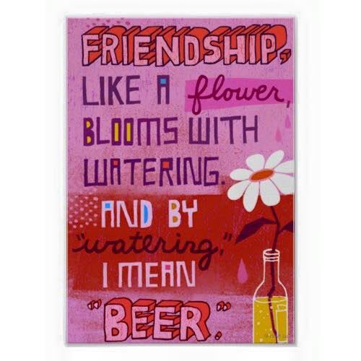
SHARE YOUR KNOWLEDGE!

Slide 49
Thank You! – Questions?
Experimental Brewing! (http://experimentalbrew.com/)
drew@experimentalbrew.com, denny@experimentalbrew.com

