Slide 1
Sanitation with Craft Meister and BTF Iodophor
March 17-18, 2017

Slide 2
biography
Jonathan Ettlie
jonathan@nationalchemicals.com
Home brewing since 2001
Ten years restaurant experience
Opening crew member of Northern Brewer Milwaukee
Brewing Ambassador, National Chemicals since 2014
Member of Beer Barons of Milwaukee

Slide 3
About national chemicals, inc.
Incorporated in 1947
Mission: To be the most trusted name in specialty chemical solutions
Target markets
Breweries & Home Brew Stores
Beverage System Maintenance
Food and Beverage service

Slide 4
Basics of cleaning and sanitizing
Terminology and procedures

Slide 5
Why is sanitation so important?
You can’t make great beer with dirty gear
Fermentations are susceptible to outside contamination
Reducing contamination increases success
Success leads to consistency
Consistency leads to a happy homebrewer

Slide 6
Cleaning vs. sanitizing
What’s the difference?
Cleaning = removal of physical dirt and debris
Carbohydrates, proteins, mineral scales
Visible and invisible soils
Sanitize = 99.9% kill of bacteria
Cannot sanitize without cleaning first!
Cleaners aren’t sanitizers, sanitizers aren’t cleaners
Use the right tool at each step

Slide 7
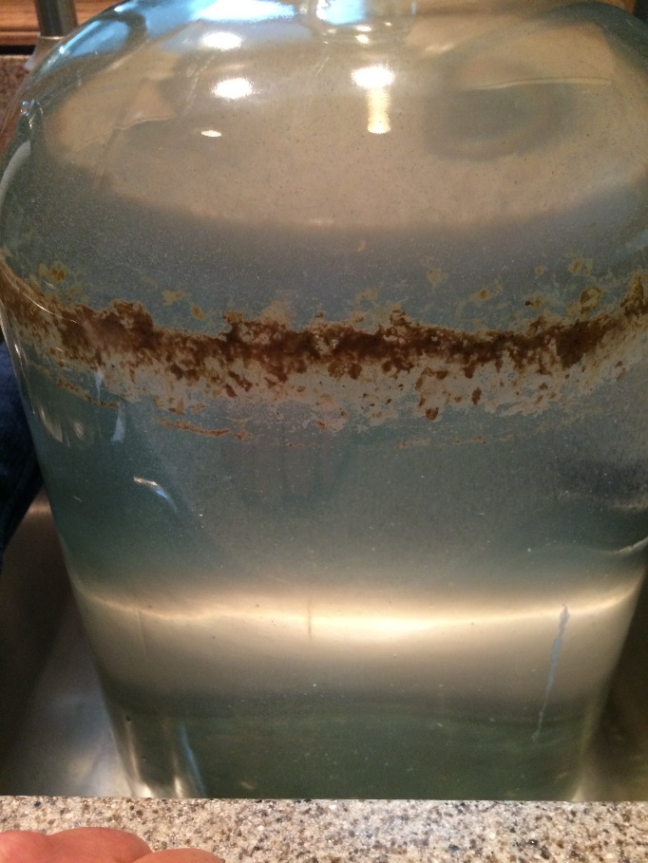
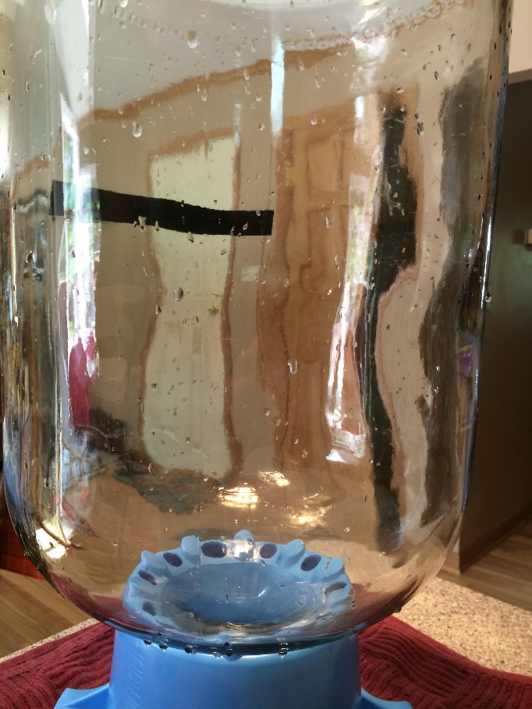
Cleaning methods
Pre-rinse with water
Loosen debris, remove loose soils
Apply detergent
Soak, recirculate
Elbow grease
Brushes, non-abrasive scrubbies
Rinse away detergent and debris
Inspect to ensure it’s clean

Slide 8
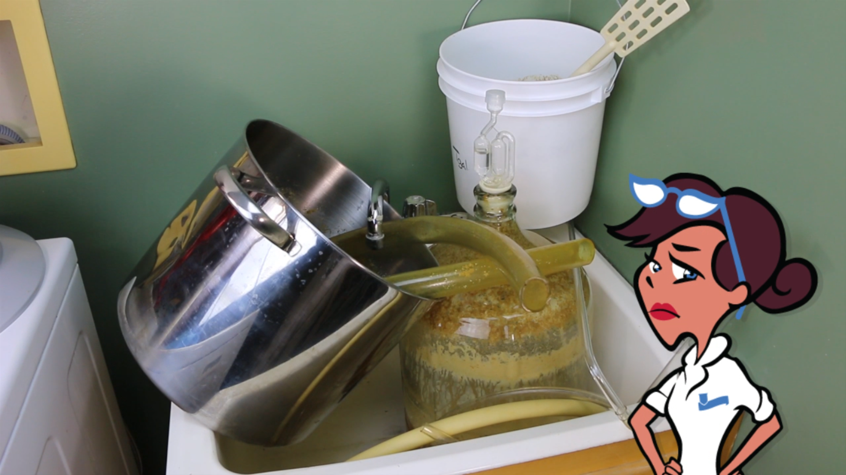

Slide 9
What needs to be cleaned?
Mashtun
Hot water rinse, grain removal
False bottom
Boil kettle
Soak & scrub with detergent after every brew
Hot Liquor Tank
Minimal, inspect for scale
Fermenters
Carboys, conicals, buckets
Detergents with soak, recirculate or brush
Kegs and bottles
Airlocks, tubing, valves, fittings

Slide 10
What is a sanitizer?
EPA registration and approval
Criteria for acceptance
Reduce microbial levels of two standards: Staphylococcus aureus & Escherichia coli
99.9% reduction in five minutes or less
EPA tests these claims for approval
Physical sanitizing
Heat, steam, hot water
Chemical
Iodophor, anionic acid, quaternary ammonia, peroxyacetic acid, hypochlorite, etc.

Slide 11
What needs to be sanitized?
Be paranoid!
Post boil, sanitize all contacts
Sanitize as close to contact as possible
Spoons, chillers, tubing, bottles, kegs, fermenters, etc.

Slide 12
How to sanitize
Mix solution to manufacturer specs
Apply to contact surface
Dip and shake (spoons, tubing, parts)
Fill completely and dump
Fill partially, swish, and dump
Recirculate (SIP)
Drain and drip dry

Slide 13
Craft meister product portfolio
Product descriptions and usage

Slide 15
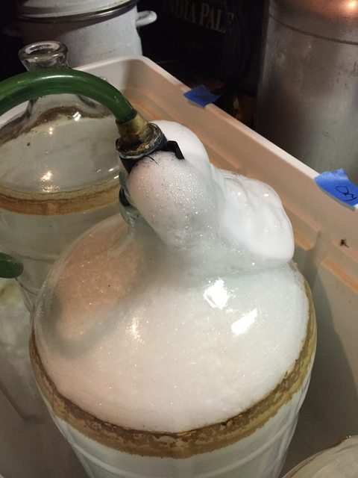
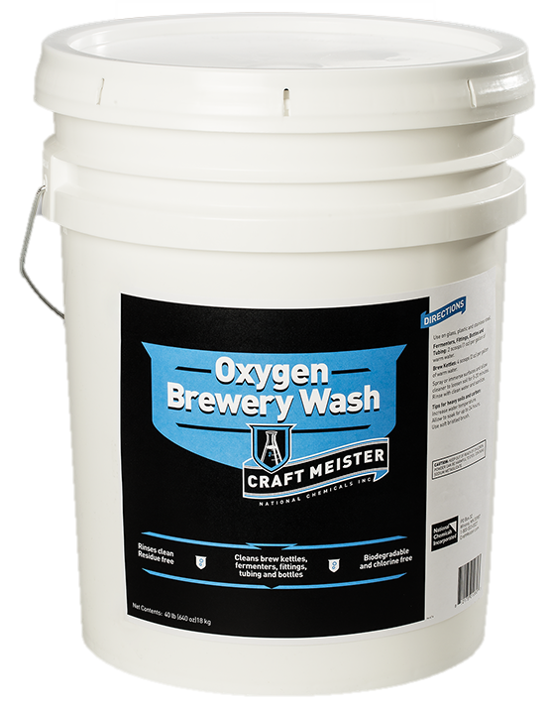
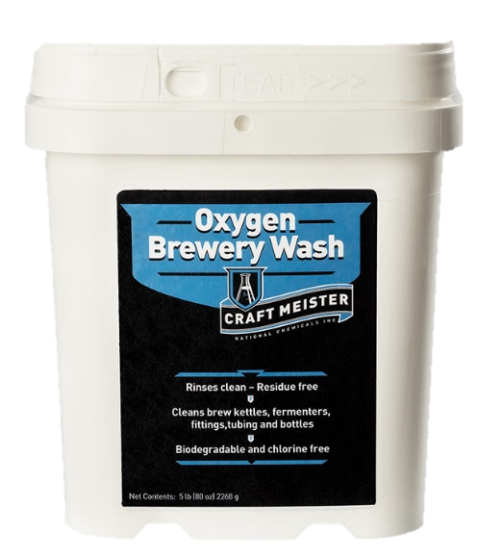
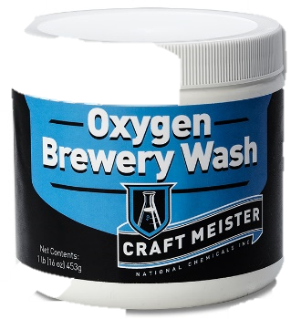
Craft meister oxygen brewery wash
Active oxygen and alkaline detergents
Fast dissolving
Lower temperature
No chalky residue

Slide 16
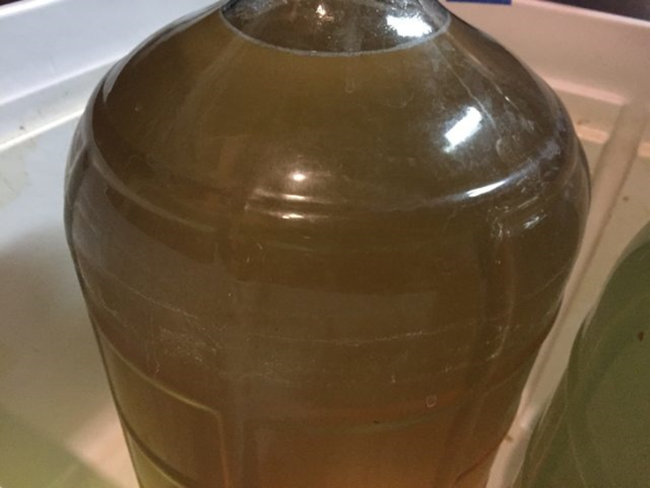
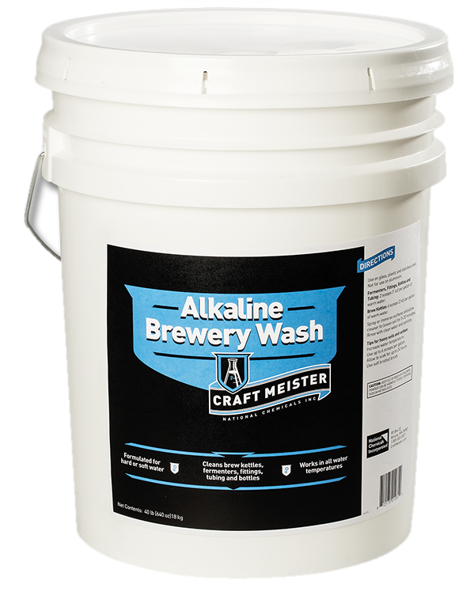
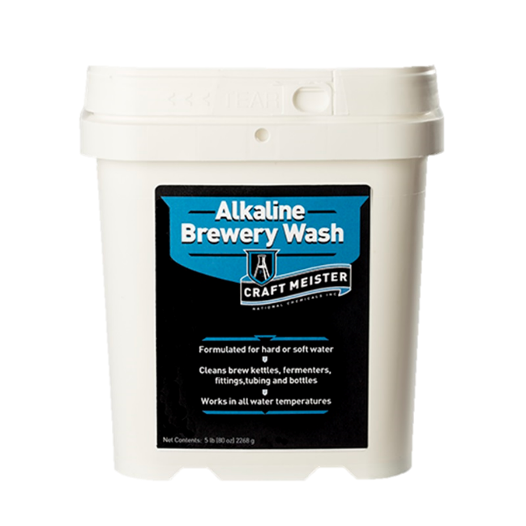
Craft meister alkaline brewery wash
Dissolves and cleans in cold water
Non caustic
Great for CIP and recirculating systems
Rapidly strips bottle labels

Slide 17
Oxygen versus alkaline brewery wash
OXYGEN
Alkaline
Active oxygen
Compare to
OxiClean™
One Step
Easy Clean
B-Brite™
PBW™
Warm water
Sit and soak
No active oxygen
Professional caustic
Cold water
Recirculation and sit and soak

Slide 18
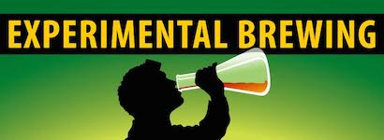
Craft meister vs. pbw™
Left to Right after 50 minutes
Alkaline Wash
Oxygen Wash
PBW™

Slide 19
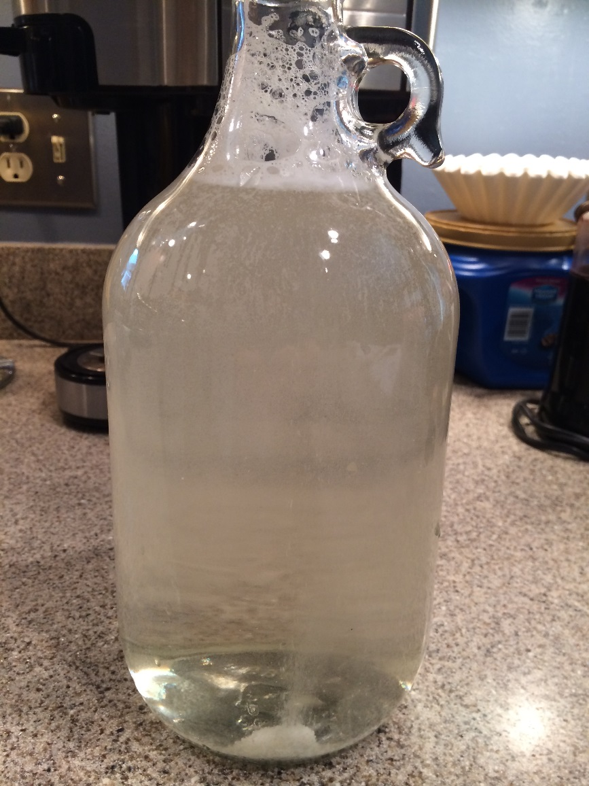
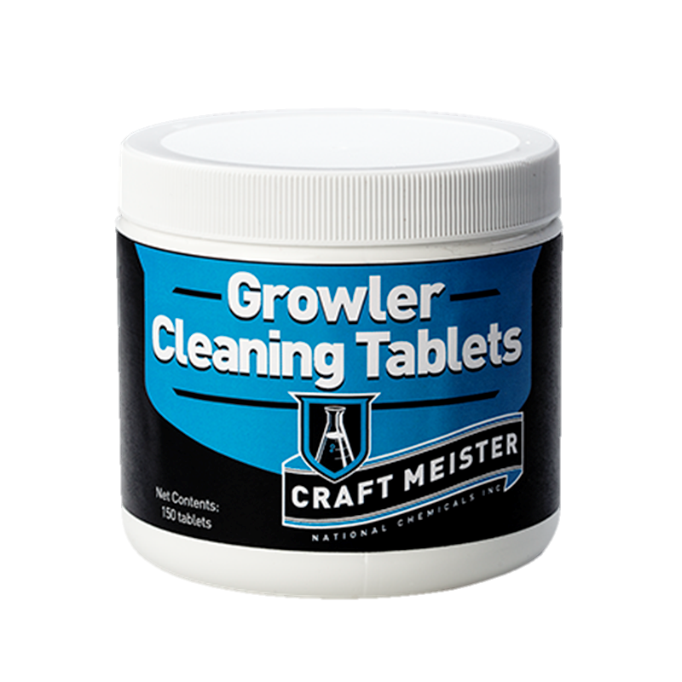
Craft meister Growler cleaning tablets
Pre-measured tablet
No brushing
Active oxygen
Multiple applications

Slide 20
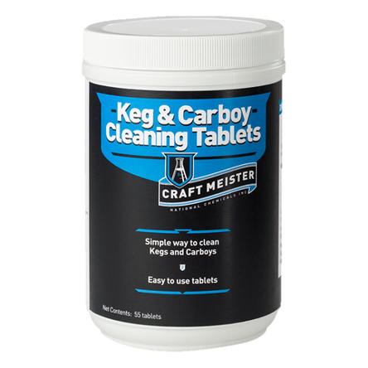
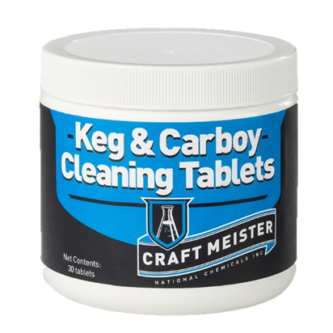
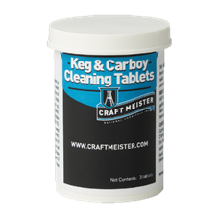

Slide 21
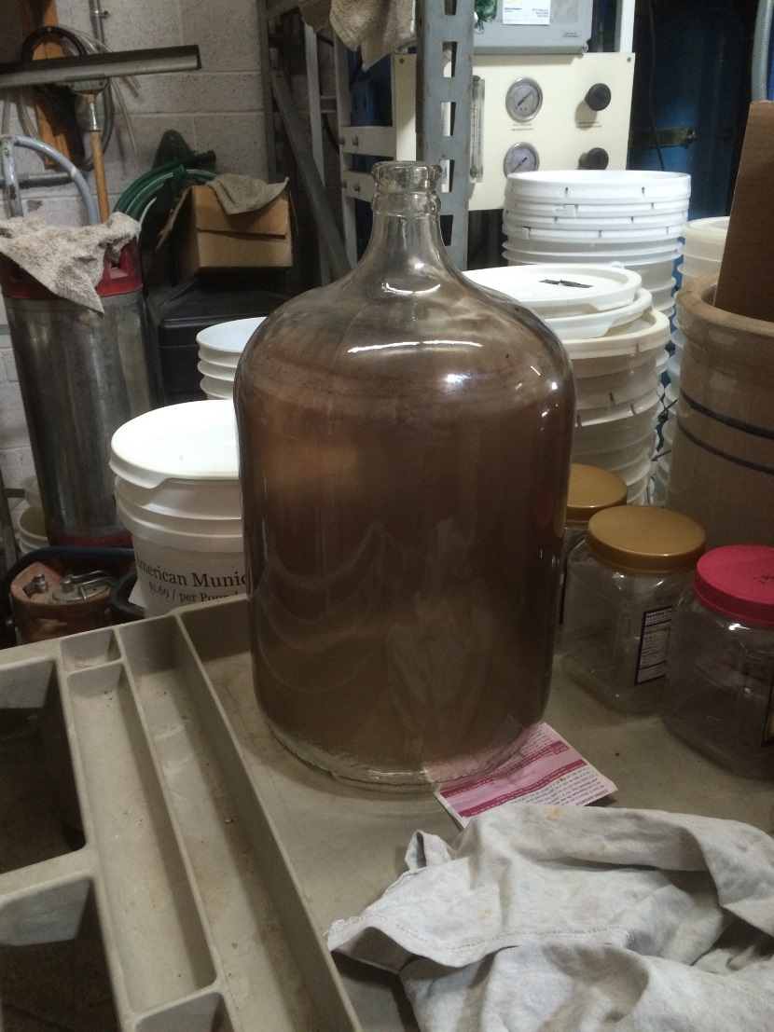
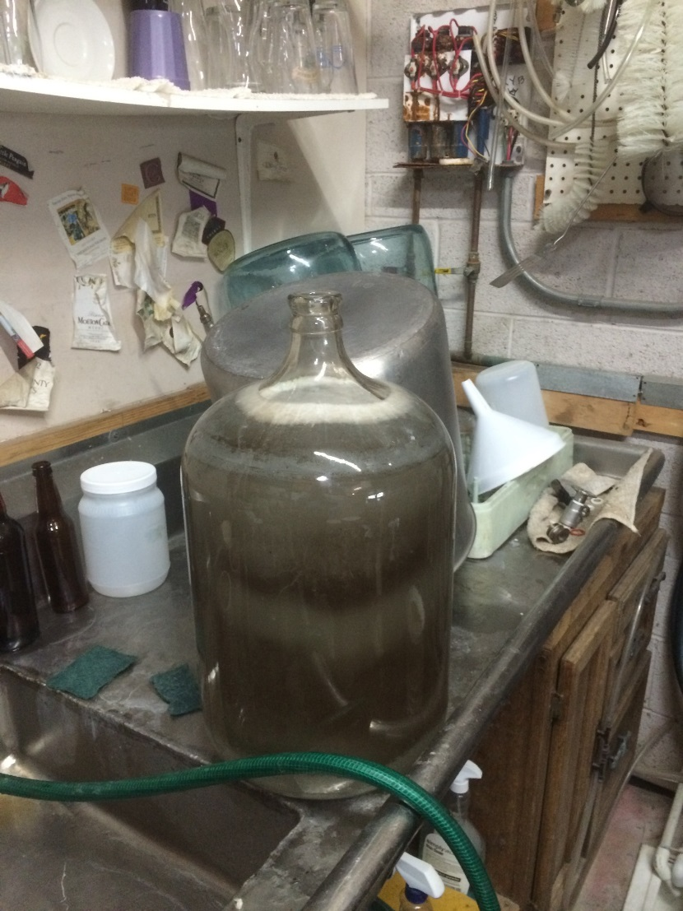
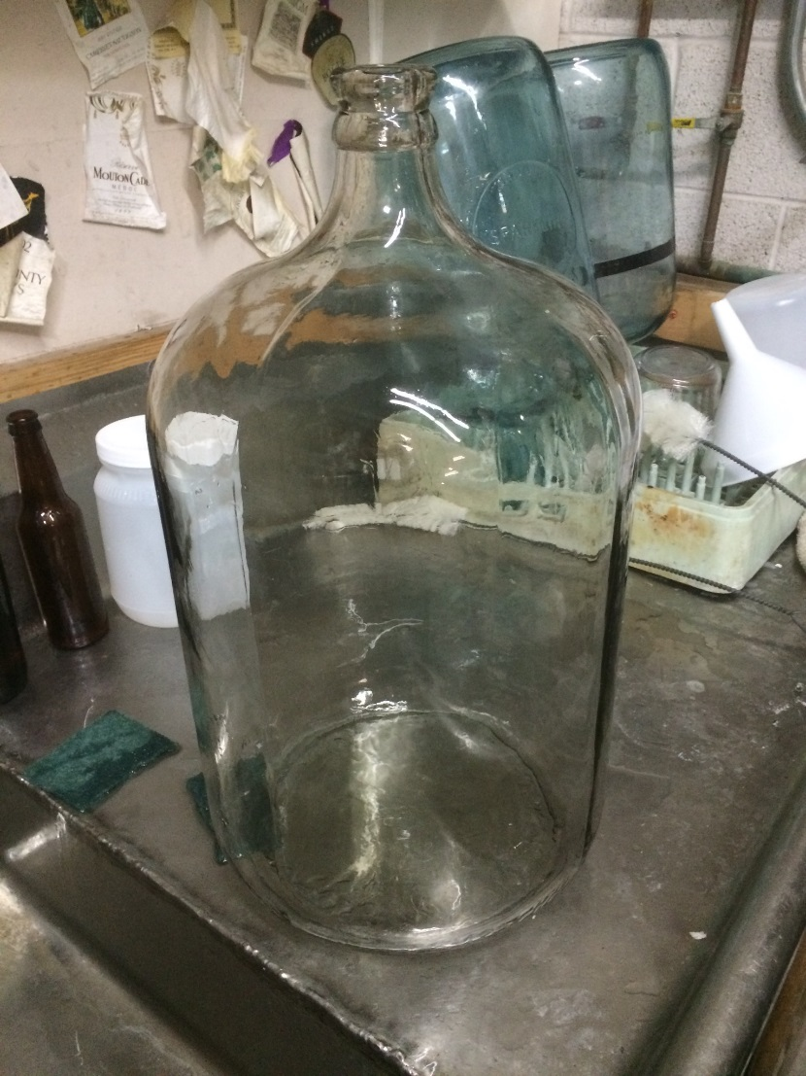
Craft meister keg & Carboy Cleaning Tablets
1
2
3

Slide 22
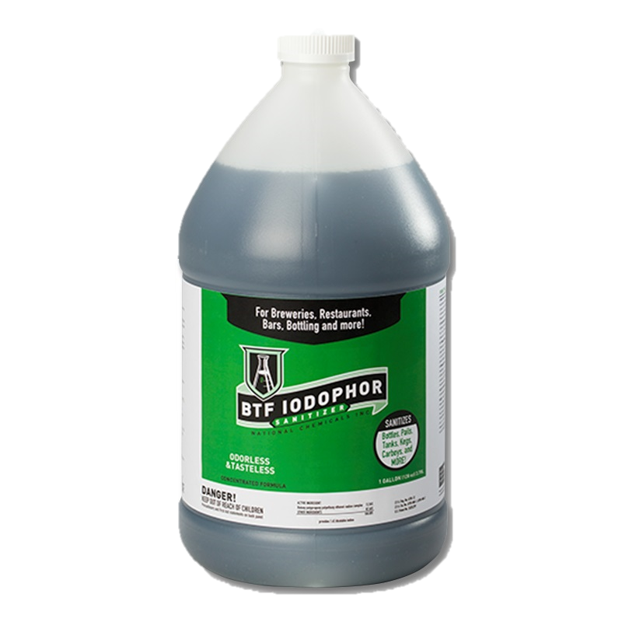
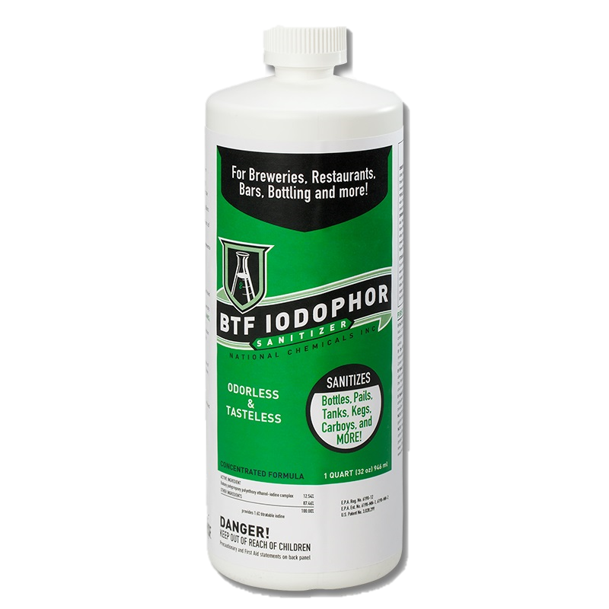
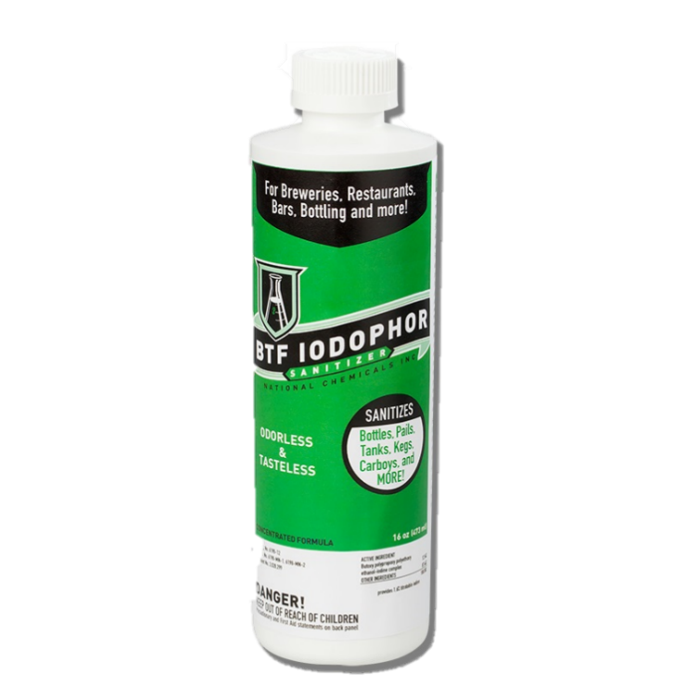
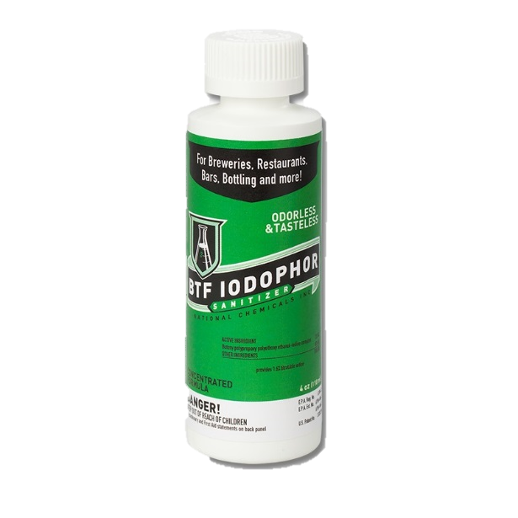
Btf iodophor sanitizer
Economical concentrate
Low foaming
No residual flavor or odor
Low cost per use
Sanitize at 12.5 PPM vs 25 PPM

Slide 23
BTF Iodophor Sanitizer
Always mix concentrate into cool or lukewarm water
Measure carefully!
Two minutes contact time
Air/drip dry
Odorless and flavorless
Solution Volume | Iodophor Amount
1.5 Gallons | 1 tsp
2.5 Gallons | ¼ oz (½ Tbl)
5 Gallons | ½ oz (1 Tbl)

Slide 24
BTF Iodophor sanitizer vs. anionic acids
BTF Iodophor
Anionic acids
Is a broad spectrum antimicrobial – halogen family
Kills
Gram positive and gram negative bacteria
Spore forming bacteria (i.e. botulism, anthrax)
Hydrophilic (Polio, rhinovirus) and lipophilic (HIV, herpes) viruses
Yeast and Mold
Meets OSHA standards for killing blood borne pathogens
Are broad spectrum antibacterial
Kills gram positive bacteria
Not
As effective against gram negative bacteria (pH <3)
Effective against spore forming bacteria
Effective against yeast and mold
Studied effectiveness against phage virus (dairy starters) and dairy mastitis bacteria

Slide 25
How does iodine work?
Penetrates cell walls
Oxidizes sulfur-hydrogen groups in amino acid cysteine
Prevents peptide synthesis and leads to cell death
No immunity or resistance

Slide 26
How do anionic acids work?
Anionic acids sanitizers carry negative charge
Attracts readily to positively charged cells
Attract and rupture
Low pH creates hostile environment
Low pH does not kill everything

Slide 27
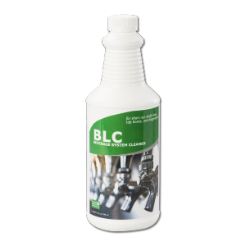
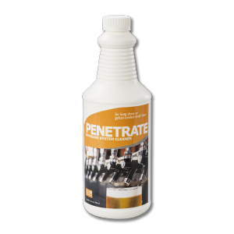
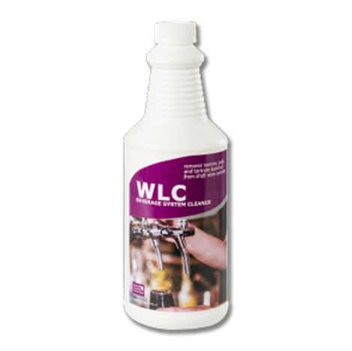
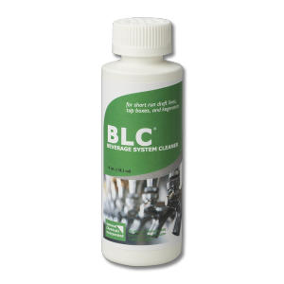
beverage system cleaners
BLC (Beer Line Cleaner)
First brewery approved liquid line cleaner
Short draw systems
½ oz BLC per quart of water
Penetrate
Commercial grade
Long draw and glycol jacketed lines
1 oz concentrate per gallon of water
WLC (Wine Line Cleaner)
Removes tannins, pulp and tartrates
Cleaning wine equipment, fermenters
1 oz WLC per gallon of water

Slide 28
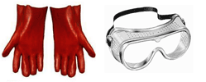
Beverage system cleaning
Recirculate or allow lines to soak
Flush with water
Re-tap and draw until beverage appears
Soak parts and faucets also
Wear gloves and goggles!

Slide 29
Final thoughts
How to learn more

Slide 30
We like to hear from you!
Have questions? Get in touch!
Call Jonathan at 1-800-533-0027 ext 1029
jonathan@nationalchemicals.com
info@craftmeister.com
http://craftmeister.com
Follow us on Facebook and Twitter
We engage our consumer base

