Slide 2
Presentation Outline
Talk about Yeast
You can interrupt anytime
If you are bored or hungover feel free to sleep at your table.

Slide 3
Imperial Yeast
Been working on the project for about 3.5 years
First full cook about 20 months ago.
Over 20 years experience in liquid yeast.
Completely open lab. Feel free to drop in anytime.

Slide 4
Imperial Organic Yeast
We provide liquid yeast, at the correct pitch rate, cheaper and organically certified, along with top notch tech service, to home and professional brewers.

Slide 5
What a yeast lab looks like
Prepare yourselves for the visual section of this presentation.
If your friend can’t read good let him know to pay attention now

Slide 6
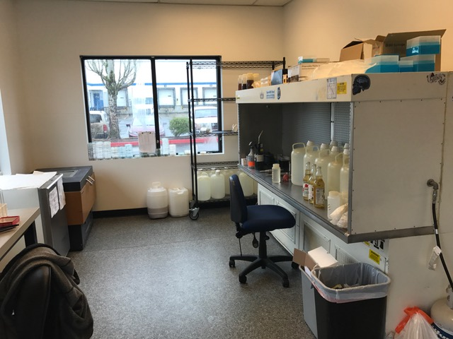
Lab

Slide 7
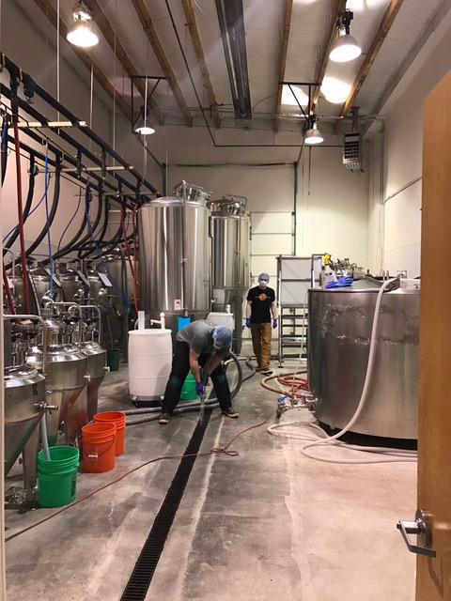
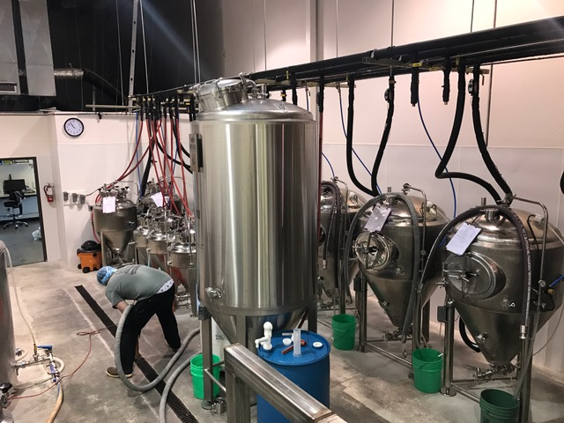
Brewery

Slide 8
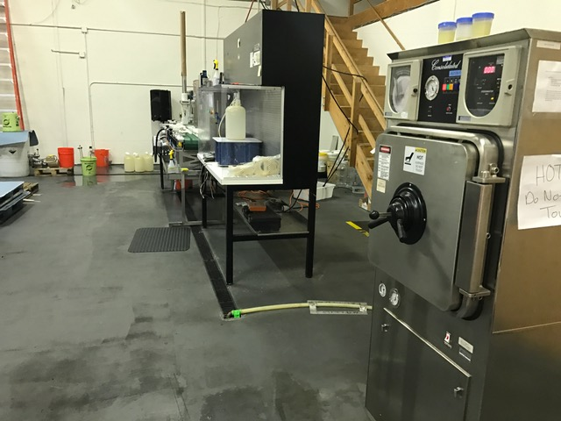
Packaging

Slide 9
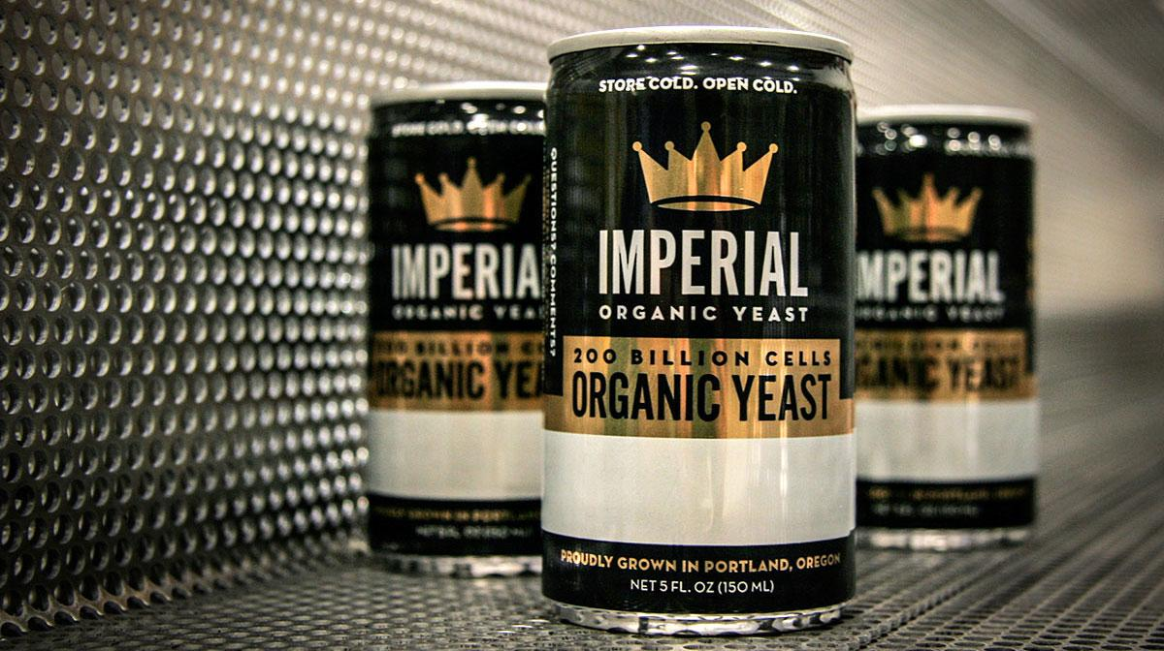
The Pitch Right Cans

Slide 10
Why Cans
Packs out well
Recyclable
Allows us to provide you 2-3 times more yeast than our competition

Slide 11
What is “Organic Yeast”
All yeast is not organic
We have to use organic sugar sources
DME and Cane Sugar
All nutrients must be mined, not synthesized
No petrochemicals
Specific Cleaning Chemicals
Tons of paperwork
$ to Oregon Tilth

Slide 12
I haven’t learned anything yet
I know.
It is early.
We were just warming up
Feel free to get more beer now

Slide 13
Imperial Pitch Rates
Liquid Yeast is packaged at 1.29 viable cells/ml
155 ml per can
1 can in 5 gallons = 10.5 million cells/ml
For ales most brewers use 0.75 million cells / ml / °P
Matches up exactly with 14°P(1.057 OG) wort.
For lagers most brewers use 1 million cells/ml/°P
Matches up with 10.5°P (1.042 OG) wort
Can pitch at ale pitch rates with a fermentation start around 60°F
On can is good for 5 gallons at about 18°P
after that, use a starter or multiple cans

Slide 14
Starters
We recommend 72°F and 10°P (1040 OG) wort
Stir plate
1 can into 2L yields about 400 Billion cells
TG in 12-24 hours
No stir plate
1 can into 4L yields around 400 Billion cells
TG in 24-48 hrs
Check gravity and remove from stir plate at TG.

Slide 15
Harvesting
Rack beer off yeast
Mix and remove yeast into a sanitized, sealable container
Refrigerate
When ready to pitch, measure about 200ml (200g) of yeast per 5 gallons at average gravity
Extra 45 ml accounts for trub and protein.
Storage times
Hours = great
Days = good
Weeks = eh?
Months = buy another can

Slide 16
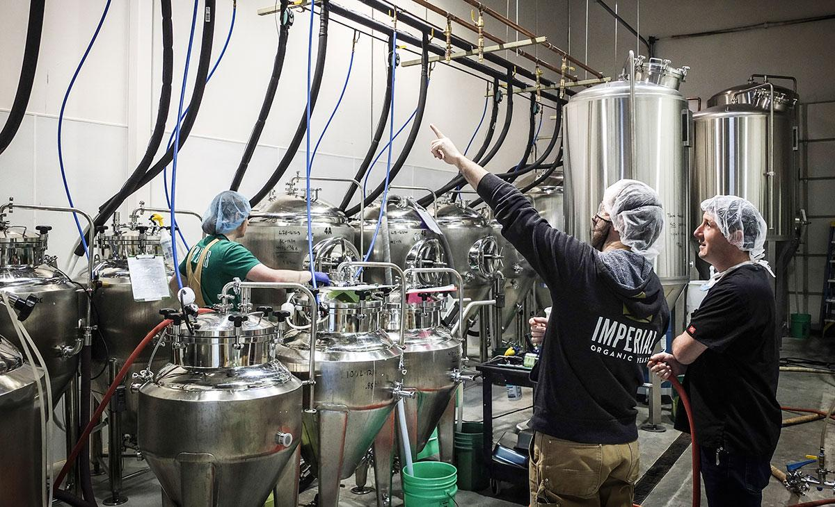
Simple tests to make your beer better

Slide 17
VDK
Put 2 samples of beer in 50 ml tubes and cap loosely
Incubate 1 sample at 150°F for 20 minutes
Hold other sample at room temp
Smell both samples
if both are buttery, you have a long ways to go
if heated sample is buttery, but other is not, continue with D rest
If both are clean you are good to go!

Slide 18
Forced Ferment
Used to determine TG of beer before fermentation is complete
Pull 500 ml of wort into container, add yeast
Cover and keep warm (75-90°F)
Incubate for 24-48 hrs until no co2 is coming from ferm
Measure gravity
If forced ferment TG is lower than fermenter TG, likely fermentables left in beer
Might want to look at o2 or pitch rates
Might not want to bottle quite yet.

Slide 19
Wort Stability
Easiest test to run!
Pull a small sample of wort (prior to pitching) into a sterilized container
Incubate warm for 1-5 days
Check sample for turbidity, co2 production
2-3 days is enough to get you a good head start with a good pitch of yeast.

Slide 20
Contact
Imperial Yeast
17268 NE Sacramento Street
Portland, Oregon 97230
503.477.5826
owen@imperialyeast.com
www.ImperialYeast.com

